Slide 1

High-speed jets and related phenomena in Earth's bow shock and magnetosheath Savvas Raptis Division of Space and Plasma Physics KTH Royal Institute of Technology, Stockholm, Sweden JHU APL presentation 19/08/2022

Slide 2
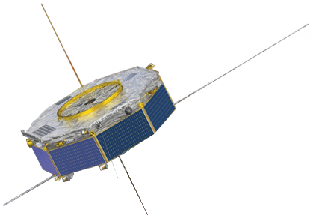
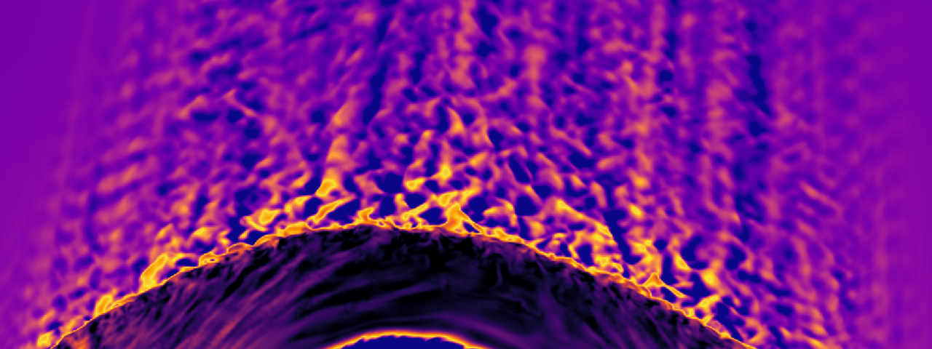
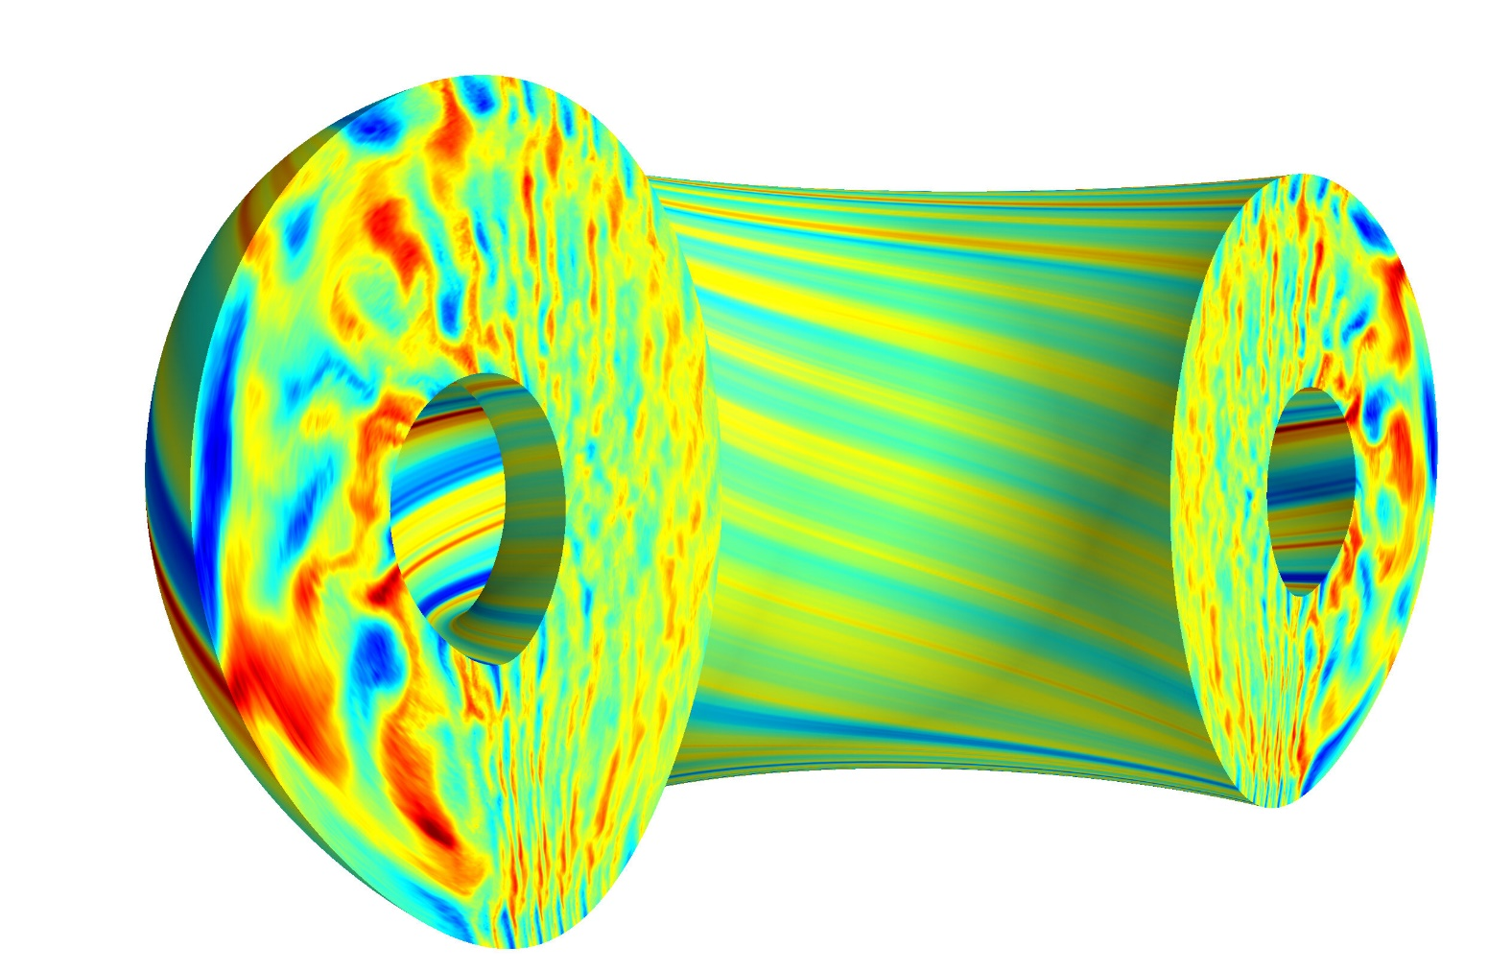
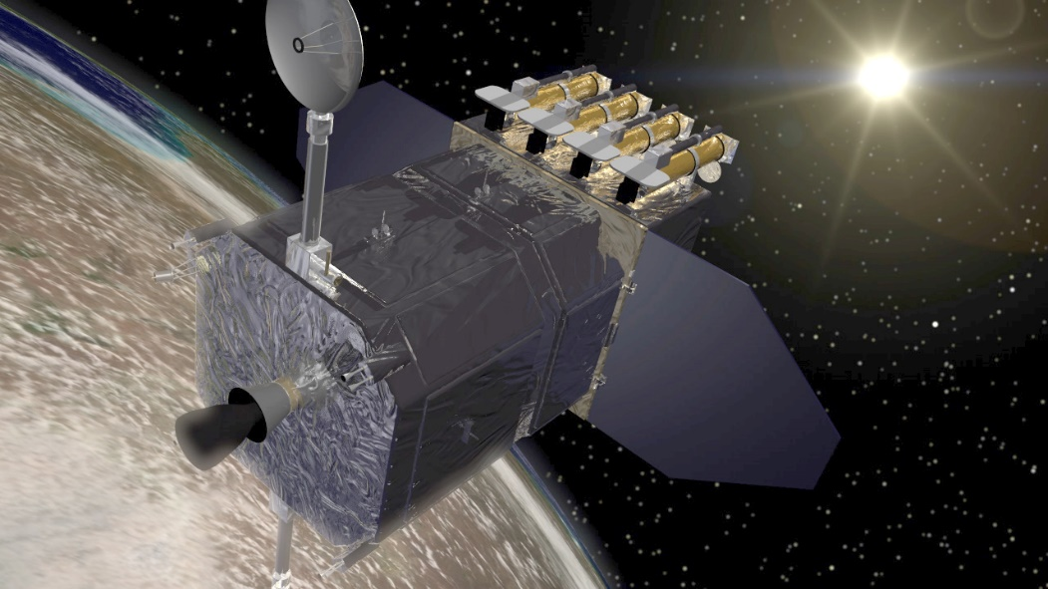
Space plasma observations & simulations
In-situ
(examples)
Cluster
MMS
THEMIS
Arase
ACE
WIND
PSP
Fluid, Hybrid, PIC, Monte Carlo
Remote Sensing
(examples)
SOHO
SDO
Solar Orbiter
SMILE
[Top] MMS/NASA
[Bottom] : SDO/NASA
[Top] : M. Palmroth, Vasiator
[Bottom] : Emily Belli, General Atomics

Slide 3
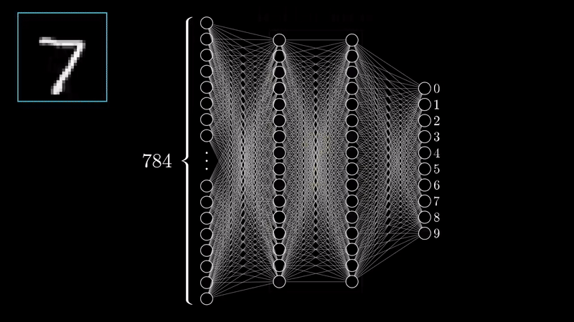
Neural Networks
*Video Courtesy: 3Blue1Brown (Check his YouTube page for more)

Slide 4
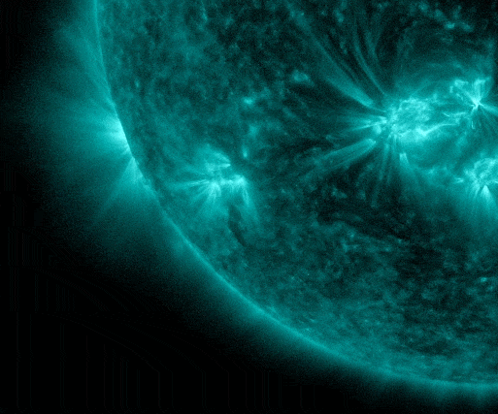
Application on forescasting SEPs
Problem description
Modeling
Validation & Results
 | SEP predicted always YES | SEP predicted always NO
SEP occurred YES | 191/220 [86.81 %] | 19/220 [8.63%]
SEP occurred NO | [7.77 %] | [92.23%]
24 features
Occurrence of SEP based on X-rays of flares
Comparisons to other models recently published
Review of Solar Energetic Particle Models (Advances in Space Research)
Aminalragia-Giamini, Raptis et al. (2021) | J. Space Weather Space Clim
Notes:
Using GOES SXR data

Slide 5
Introduction & previous results
Raptis, Karlsson, et al. (2020) | JGR
Raptis, Aminalragia-Giamini et al. (2020) | Front. Astron. Space Sci
Palmroth, Raptis et al. (2021) |Annales Geophysicae
Karlsson, Raptis et al. (2021) | JGR
Kajdič, Raptis et al. (2021) | GRL
Katsavrias, Raptis et al. (2021) | GRL

Slide 6
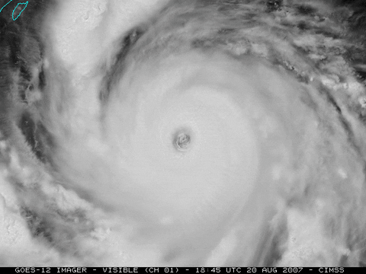

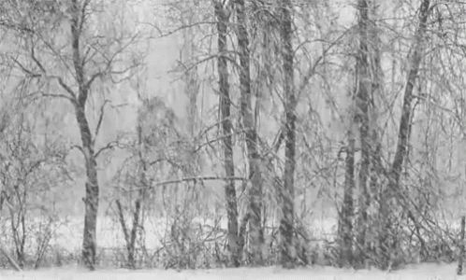
Transient events – weather
Hurricanes
Rain
Snowstorms

Slide 7
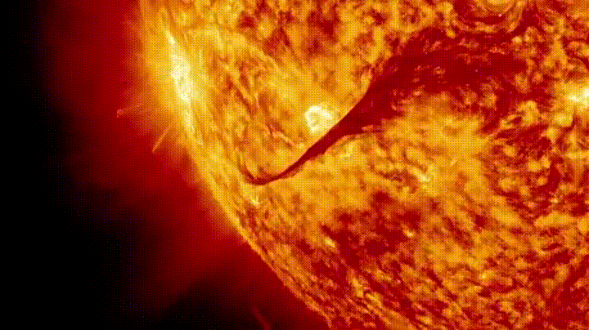
Transient events – weather
CMEs/Solar Flares
Rain
Snowstorms

Slide 8
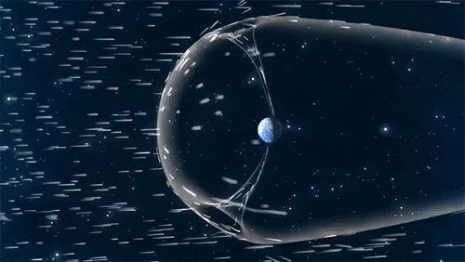
Transient events – weather
CMEs/Solar Flares
Rain
Solar cycle, streams, discontinuities
Credits : NASA

Slide 9
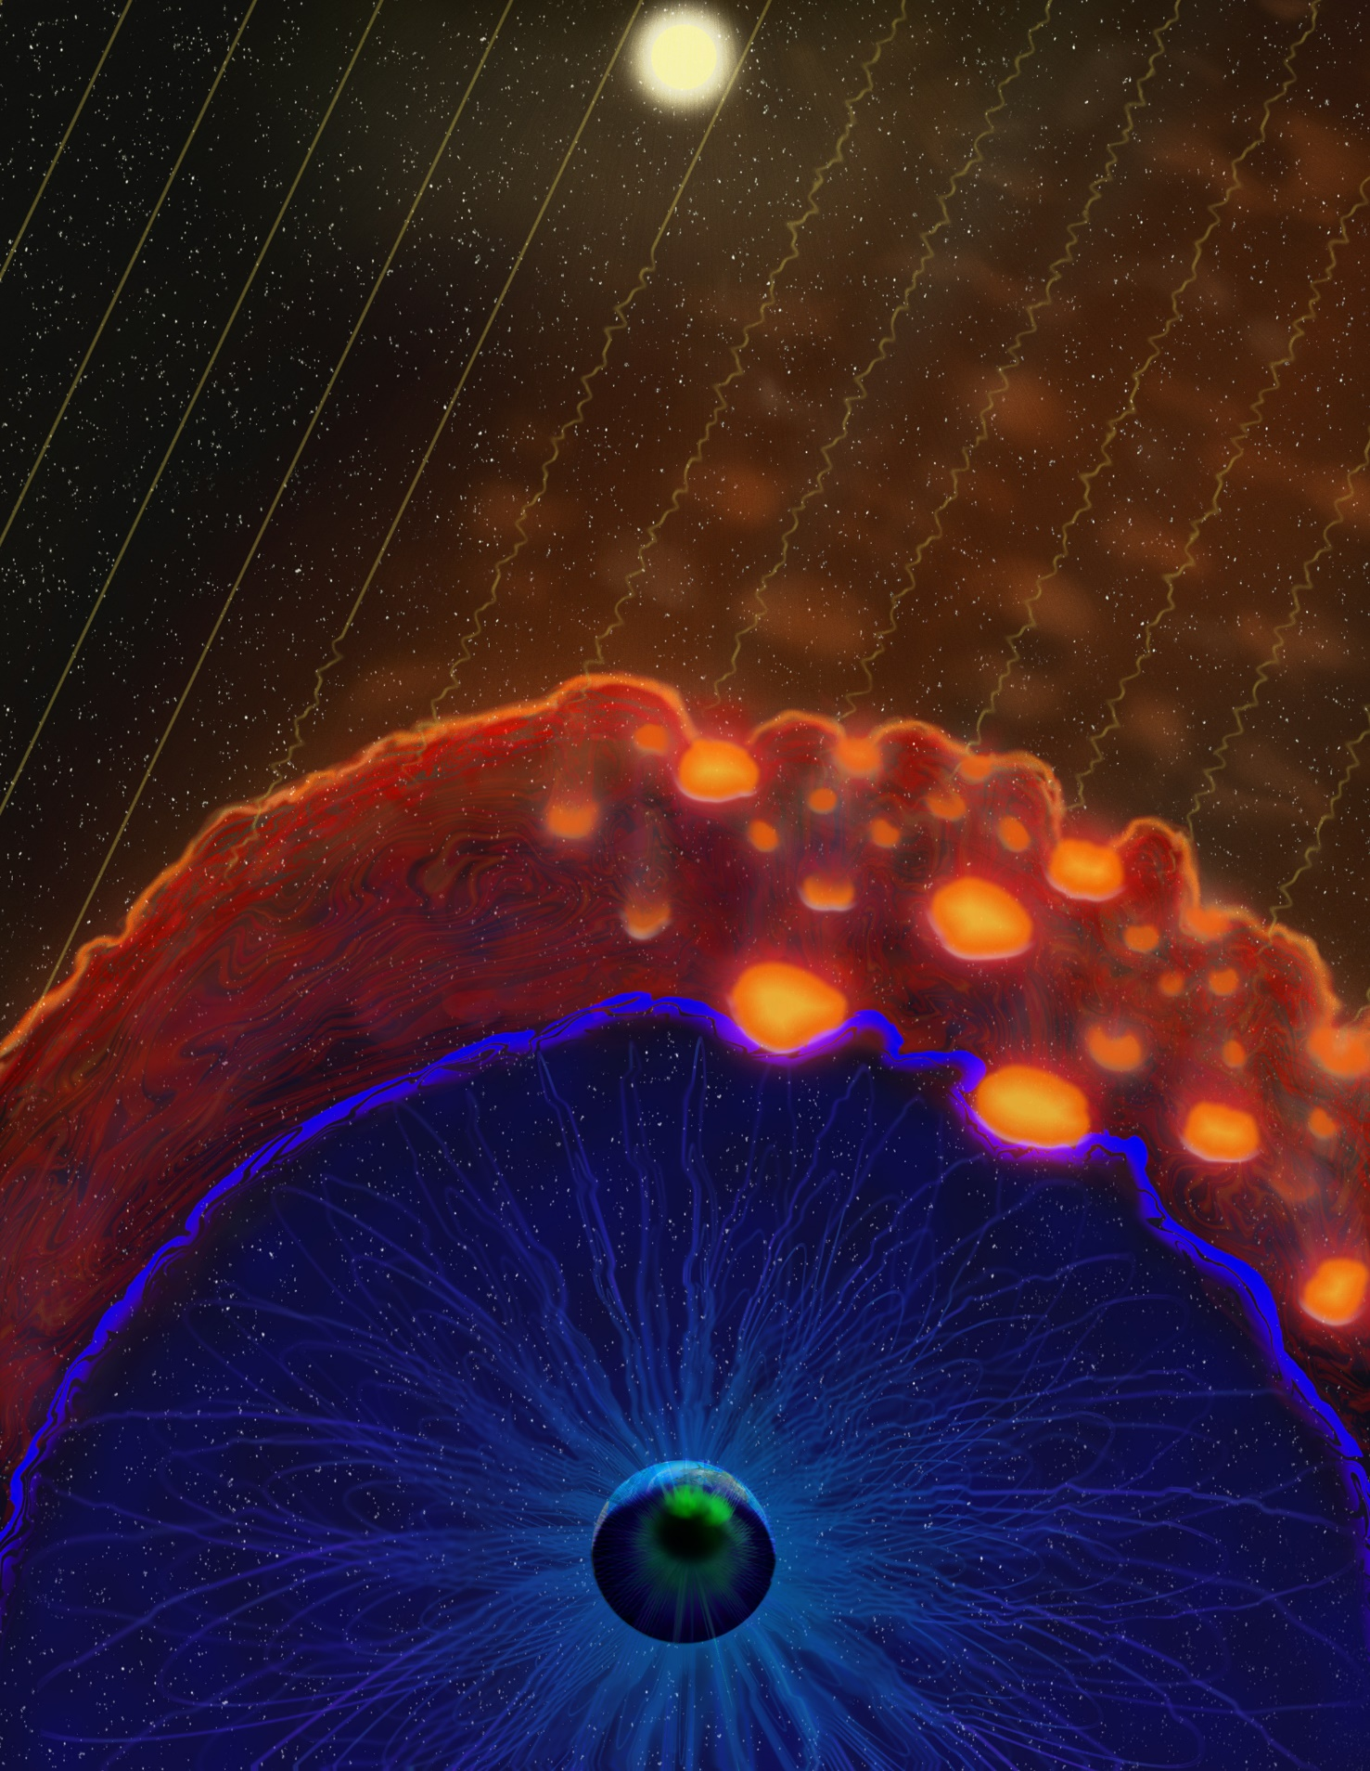
Transient events – space weather
CMEs/Solar Flares
Foreshock structures & jets
Solar cycle, streams, discontinuities
Credits : NASA
Illustration made by Emmanuel Masongsong

Slide 10
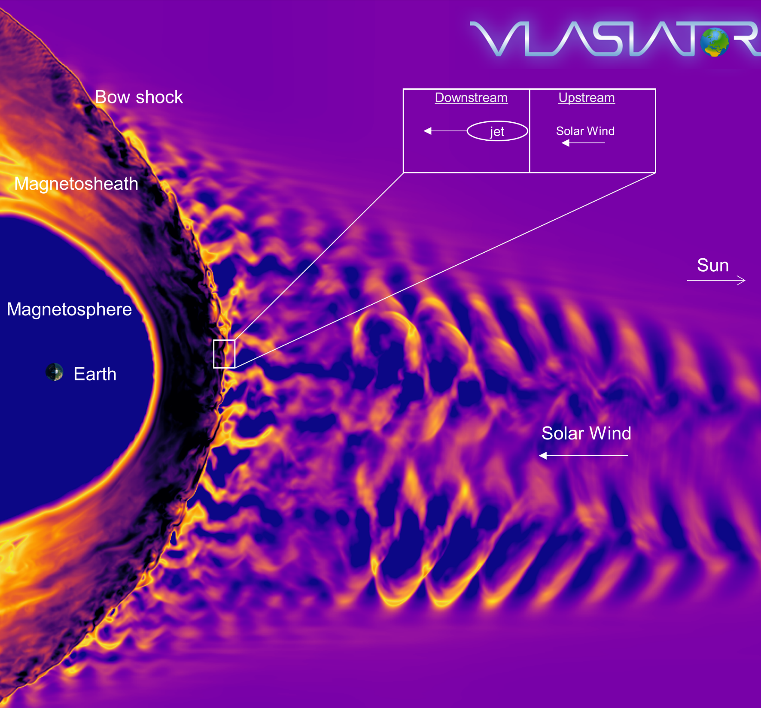
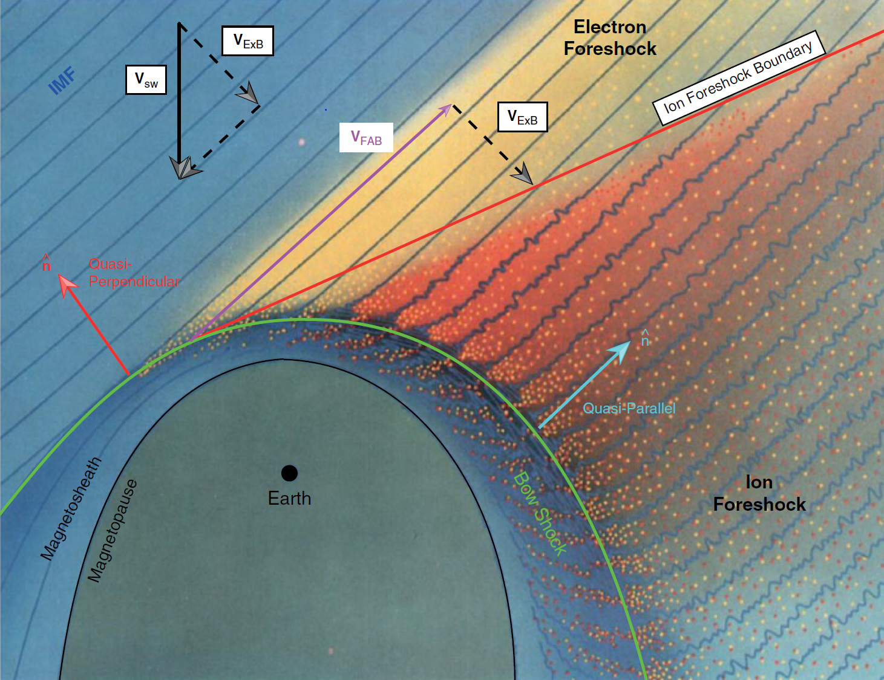
Earth’s magnetosphere & shock environment
Lynn Wilson – Solar Wind
Heli Hietala – The Bowshock and Foreshock
Ferdinand Plaschke – The Magnetosheath
https://msolss.github.io/MagSeminars/
Courtesy of M. Palmroth, U Helsinki
L. B. Wilson (2016)

Slide 11
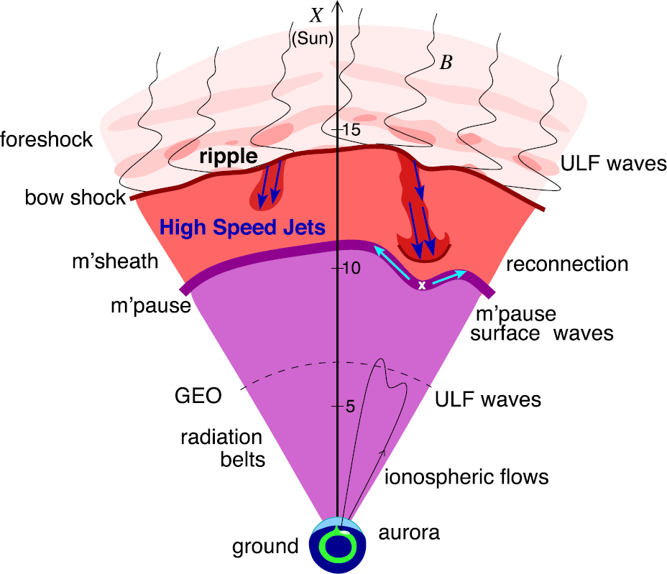
Magnetosheath jets effects
Definition
Magnetosheath jets are transient localized enhancements of dynamic pressure (density and/or velocity increase)
e.g., 200% dynamic pressure enhancement compared to background magnetosheath
Shock acceleration
Related phenomena
Radiation belts
Throat aurora
Magnetopause reconnection
Magnetopause penetration
Shock acceleration
Magnetopause surface eigenmodes
ULF waves
Substorms
Ground magnetometer detection
Plaschke F. et al. (2018); sketch by H. Hietala | Space Sci. Rev

Slide 12
Jets – references update (>2019)
Associated phenomena & effects
Excitation of surface eigenmodes at magnetopause: Archer et al. (2019, 2021)
Mirror mode waves and jets : Bianco-Cano et al. (2020)
Bursty magnetic reconnection at the Earth's magnetopause : Ng et al. (2021)
Ground-based magnetometer response : Norenius et al. (2021)
Generation of Pi2 pulsations : Katsavrias et al. (2021)
B in jets, Bz variations near magnetopause : Vuorinen et al. (2021)
Modeling & formation
Velocity & magnetic field alignment in jets : Plaschke et al. (2020)
Classification of jets using MMS & Neural Networks : Raptis et al. (2020a,2020b)
Comparison MMS vs simulations : Palmroth et al. (2021)
Solar wind effect on jet formation : LaMoury et al. (2021)
Magnetosheath Jets and Plasmoids - Hybrid Simulations : Preisser et al. (2020)
Formation of jets in Quasi-perpendicular magnetosheath : Primoz et al. (2021)
Occurrence in relation to CMEs and SIRs : Koller et al. (2022)
Jets Downstream of Collisionless Shocks
Plaschke et al. (2018)
https://link.springer.com/article/10.1007/s11214-018-0516-3
And more : Liu et al. (2020a,2020b), Omelchenko et al (2021), Sibeck et al. (2021), Suni et al. (2021), Tinoco-Arenas et al. (2022) … etc.

Slide 13
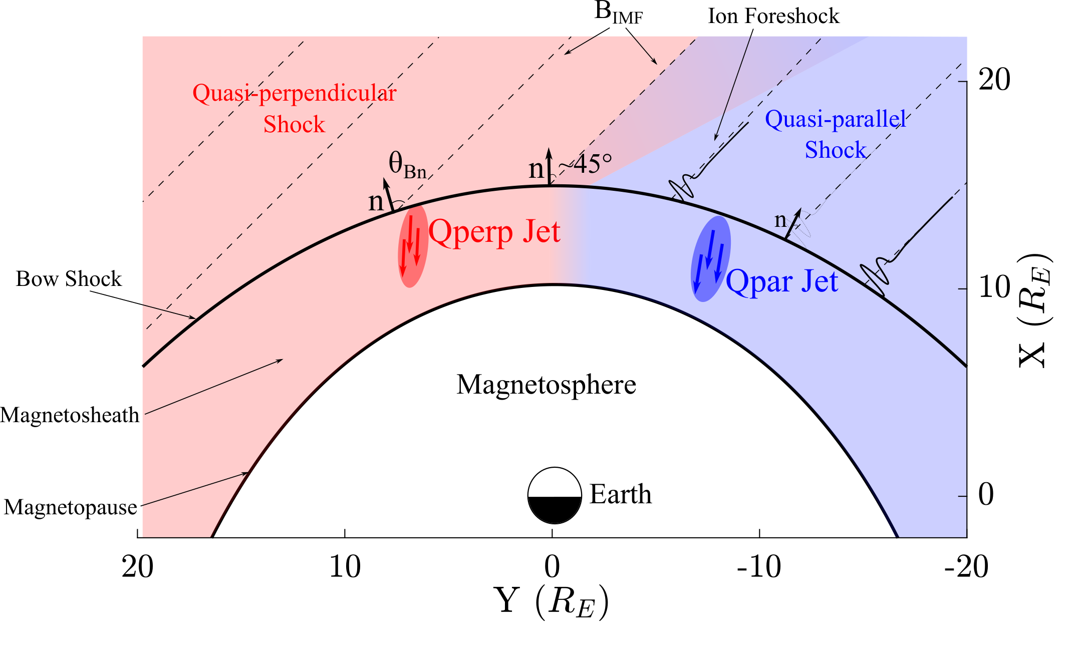
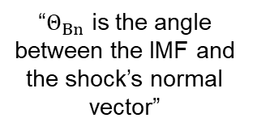
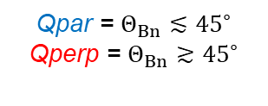
Shock, Magnetosheath & Jet classification
“$Θ_{Βn}$ is the angle between the IMF and the shock’s normal vector”
Qpar = $Θ_{Βn}≲{45}^{∘}$
Qperp = $Θ_{Βn}≳{45}^{∘}$
”~10 times more often in Qpar MSH”
Raptis, Aminalragia-Giamini et al. (2020) | Front. Astron. Space Sci

Slide 14
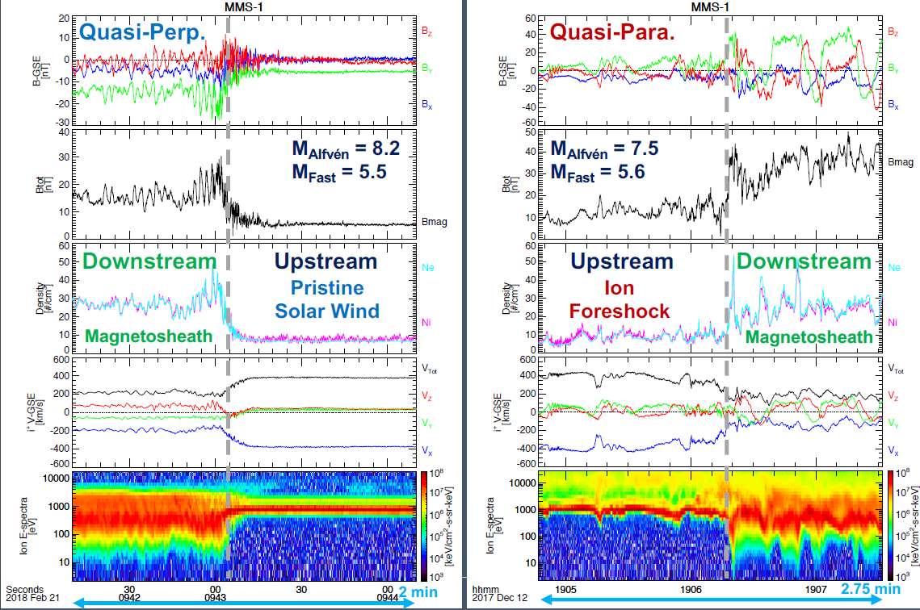
Shock transitions with MMS
Notice difference in the downstream plasma ?
Figure taken from : Drew Turner’s talk | SWSG2021

Slide 15
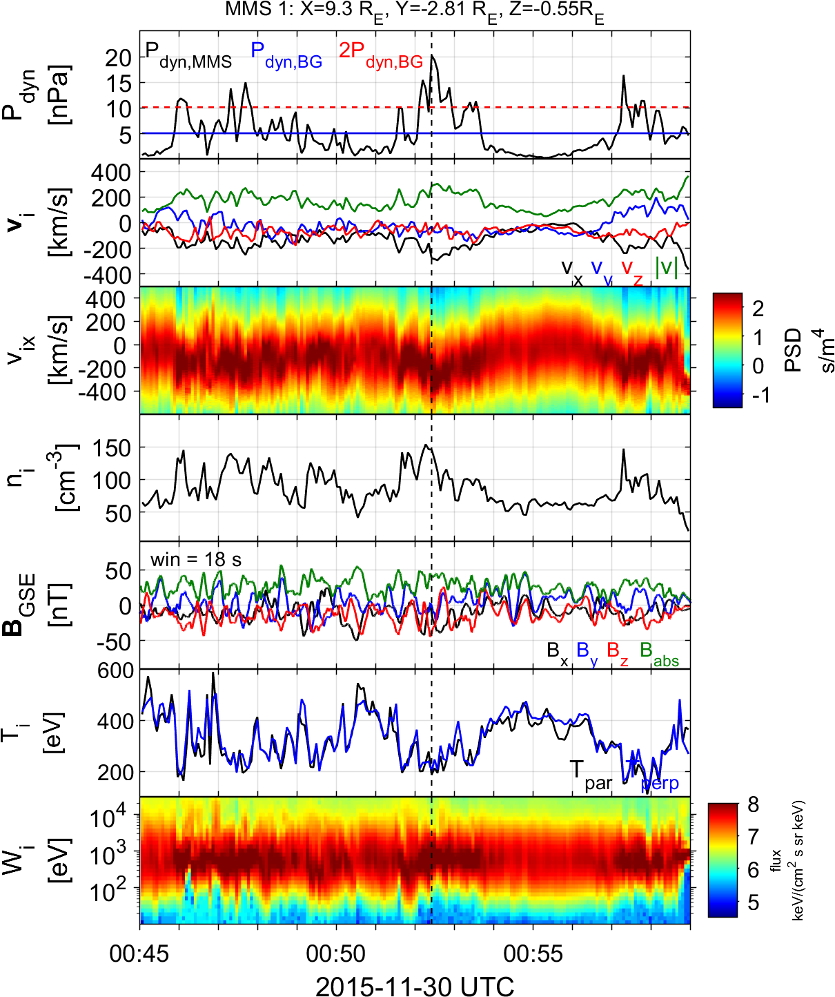
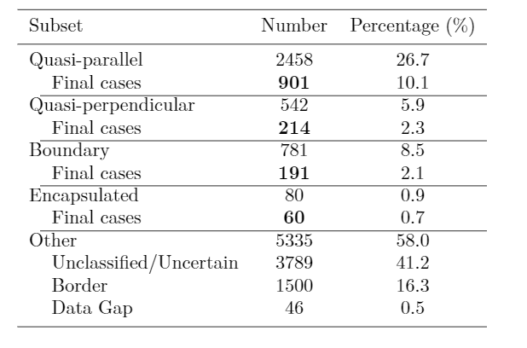
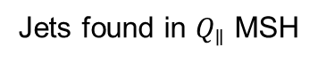
Summarized properties – Quasi Parallel
Most common
High dynamic pressure
Primarily Earthward
Associated with low temperature (ΔΤ)
Associated with high |B| & ΔΒ
High |B| variance
Relevant to magnetospheric effects
Qpar Jet
Jets found in $Q_{∥}$ MSH
Raptis S., Karlsson T., et al. (2020) | JGR

Slide 16
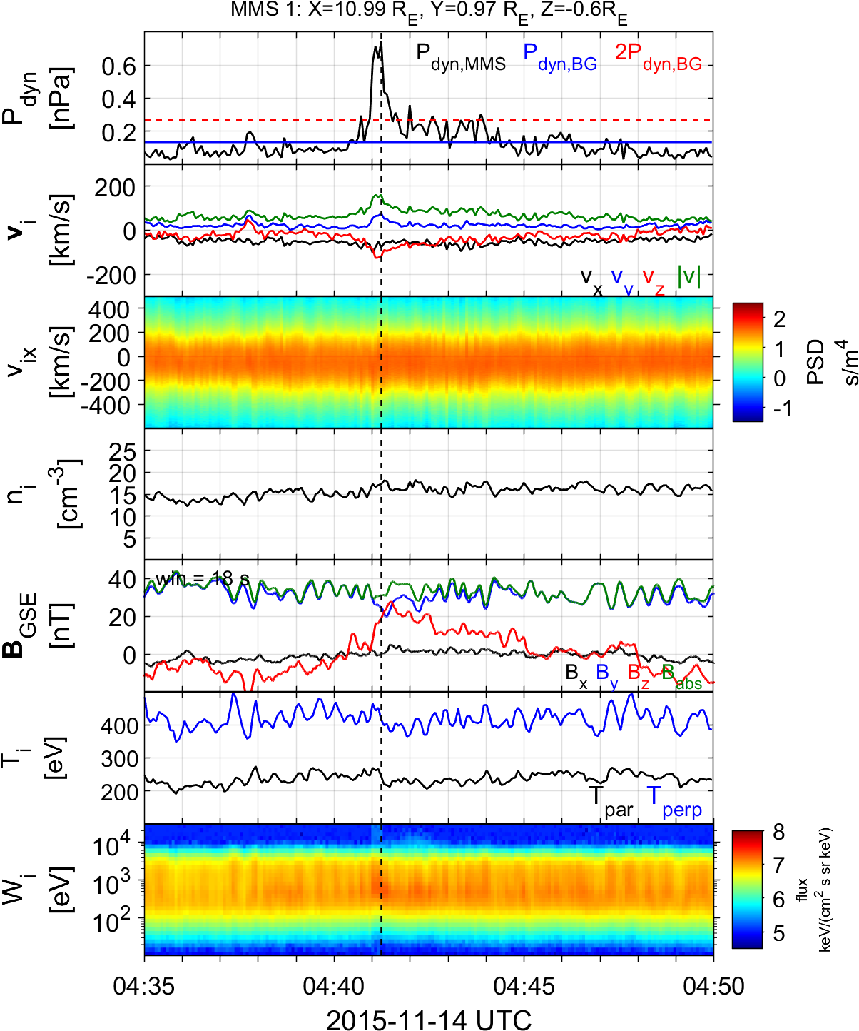
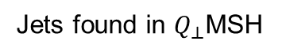
Summarized properties – Quasi Perpendicular
Less common
Less Energetic
Mainly velocity driven
Very small duration (~4 sec)
Could be connected to MSH reconnection or FTEs
Connection mirror mode waves
Qperp Jet
Jets found in $Q_{⊥}$MSH
Raptis S., Karlsson T., et al. (2020) | JGR

Slide 17
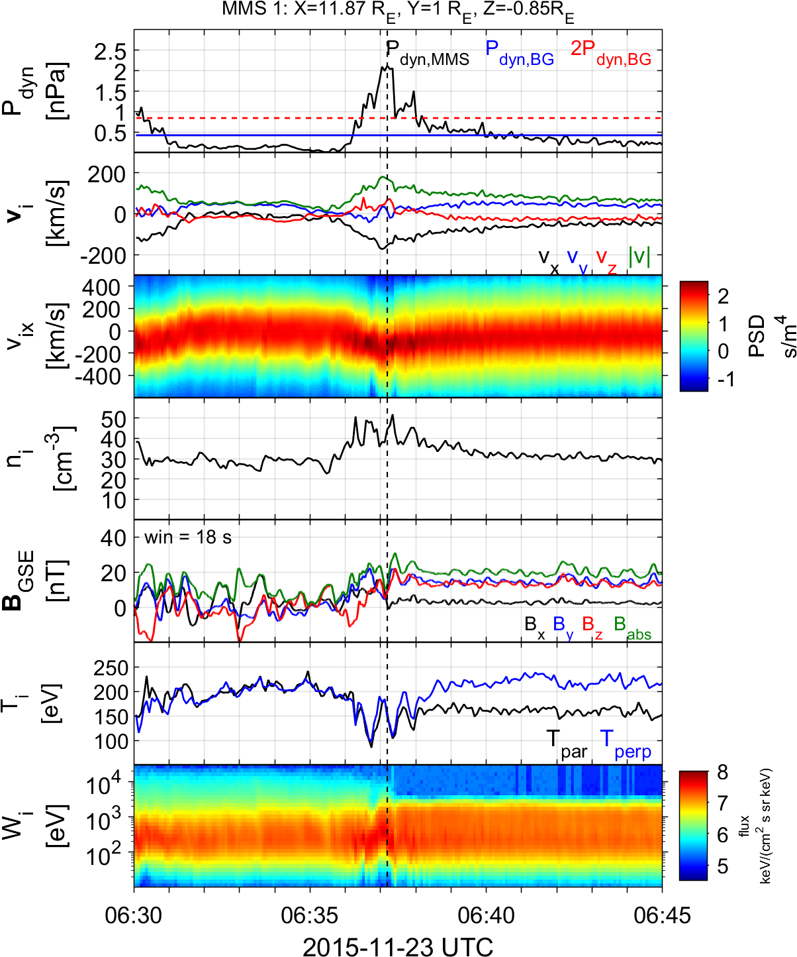
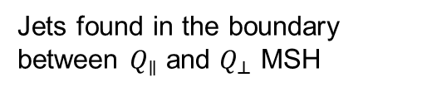
Summarized properties – Boundary
Hard to estimate their occurrence rate
Quite energetic and long duration
Similar properties to Qpar jets
Could be geoeffective (GMAGs) [Norenius et al. 2021]
Maybe associated to pressure pulses of SW [Archer et al. 2012]
Boundary Jet
Jets found in the boundary between $Q_{∥}$ and $Q_{⊥}$ MSH
Raptis S., Karlsson T., et al. (2020) | JGR

Slide 18
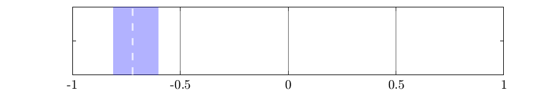
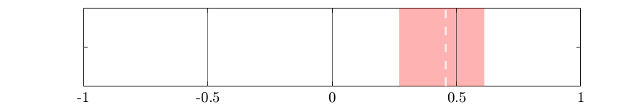
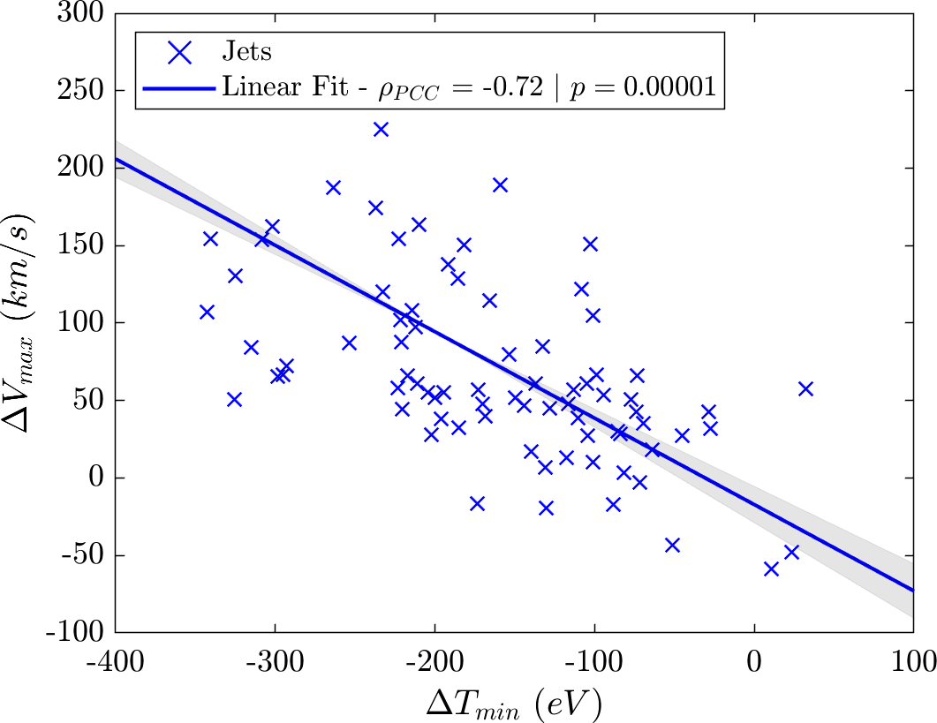
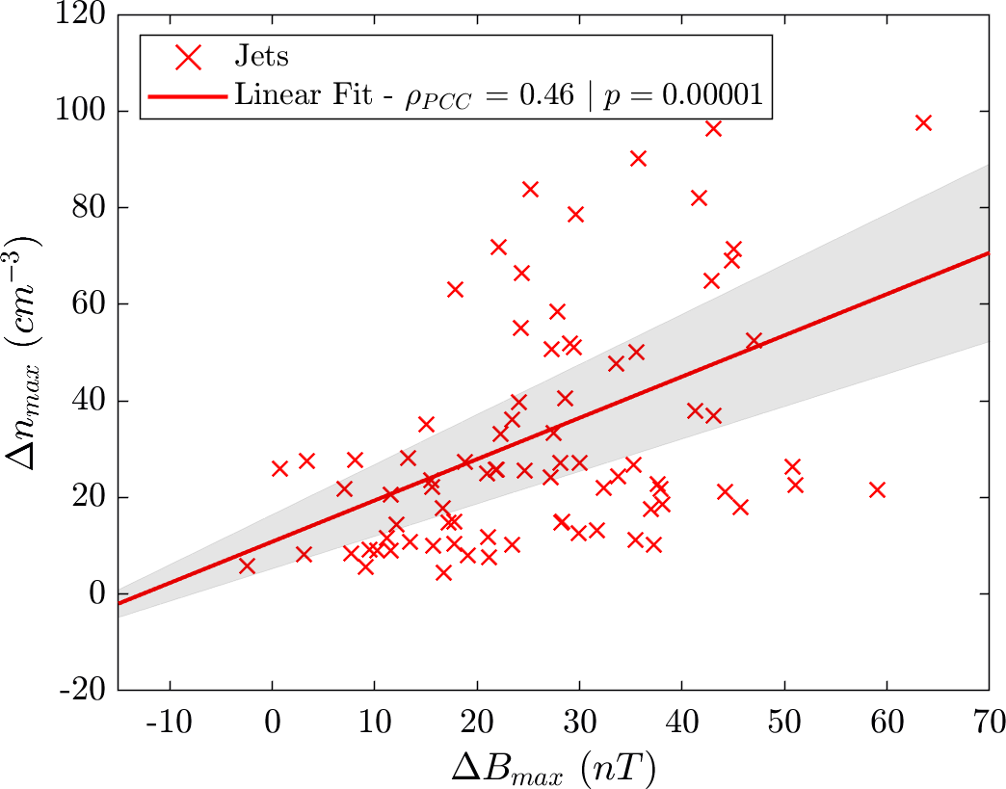
Example : statistics of subset close to Bow shock
$$n=90$$
$95\% CI:[−0.81 , −0.6$]
$95\% CI:[0.27 , 0.62$]
Raptis S., et al. | Ongoing

Slide 19
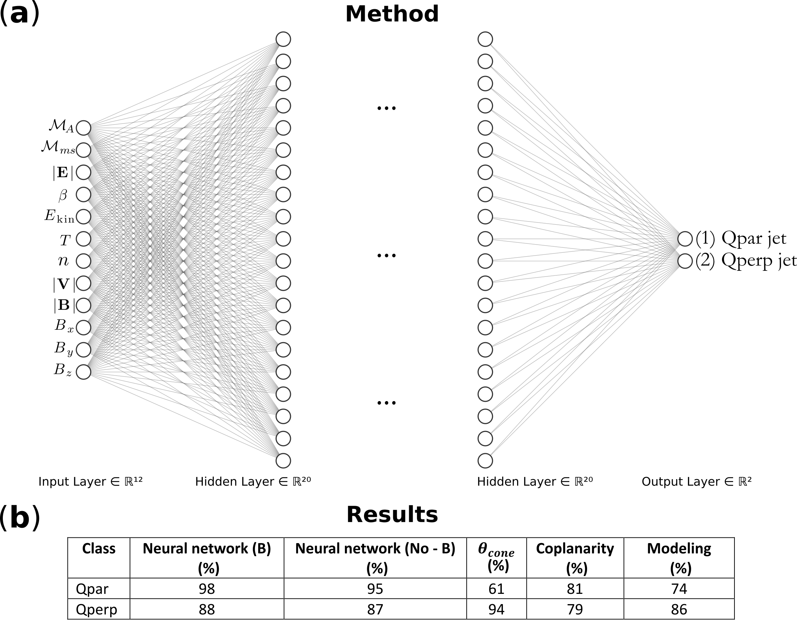
Classifying jets with Neural Networks
Upstream
SW
L1 OMNI
Downstream
MSH
MMS
Raptis, Aminalragia-Giamini et al. (2020) | Front. Astron. Space Sci

Slide 20
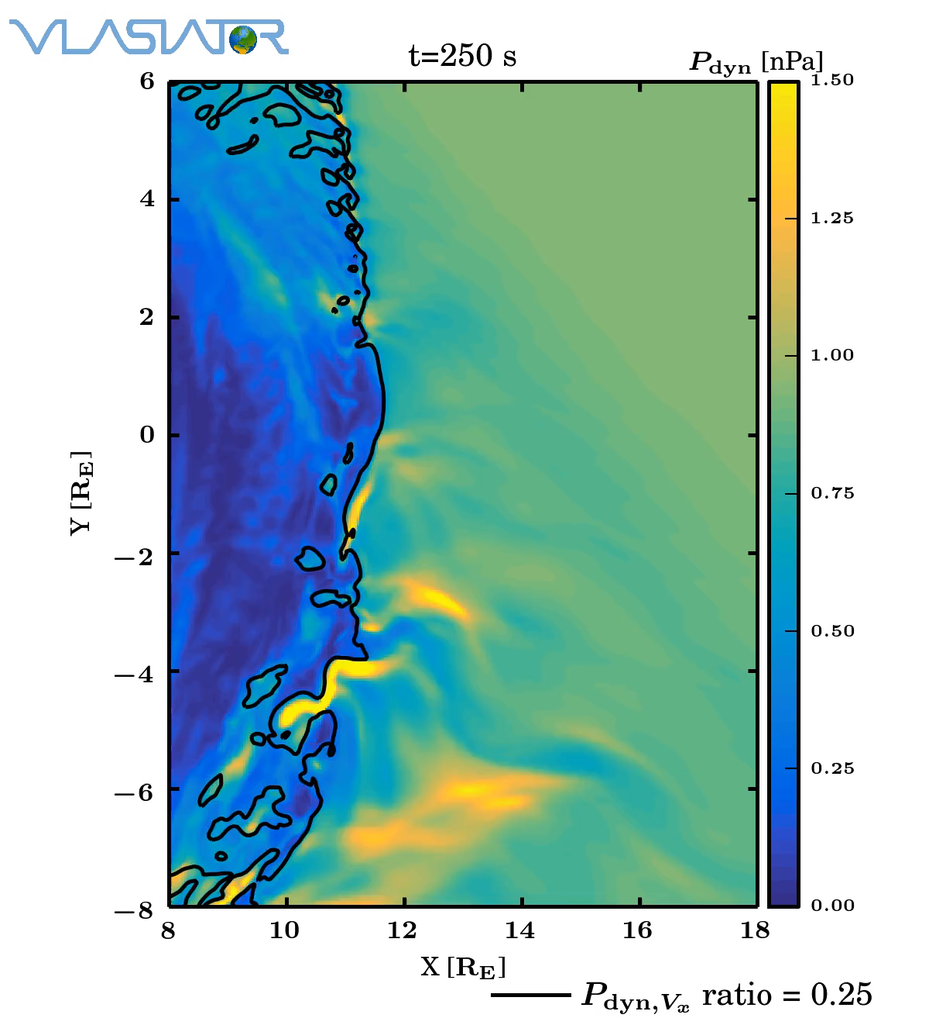
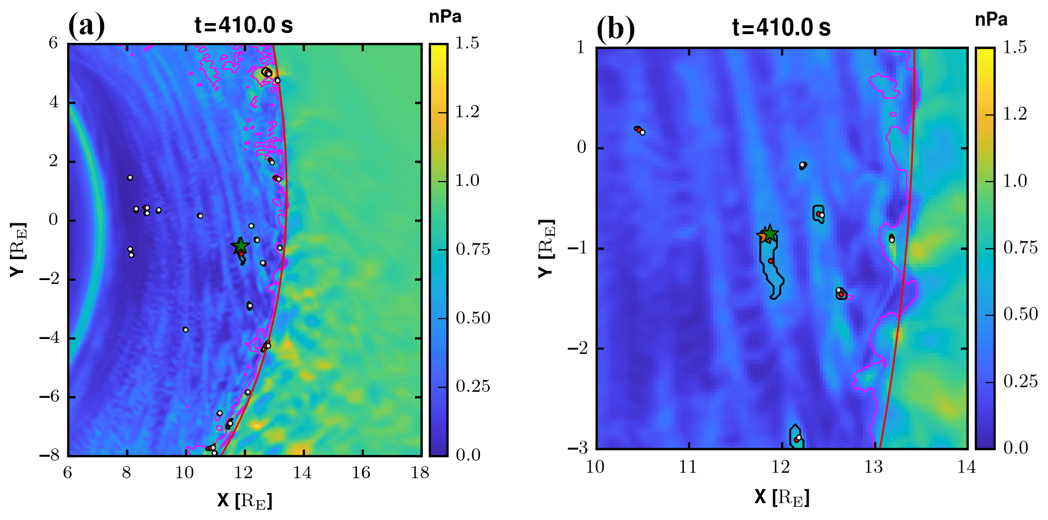
Jets in simulations
Palmroth, et al. (2018)
Palmroth, Raptis et al. (2021)

Slide 21
Comparison
MMS VS Vlasiator
Palmroth M., Raptis S., et al. (2021) | Annales

Slide 22
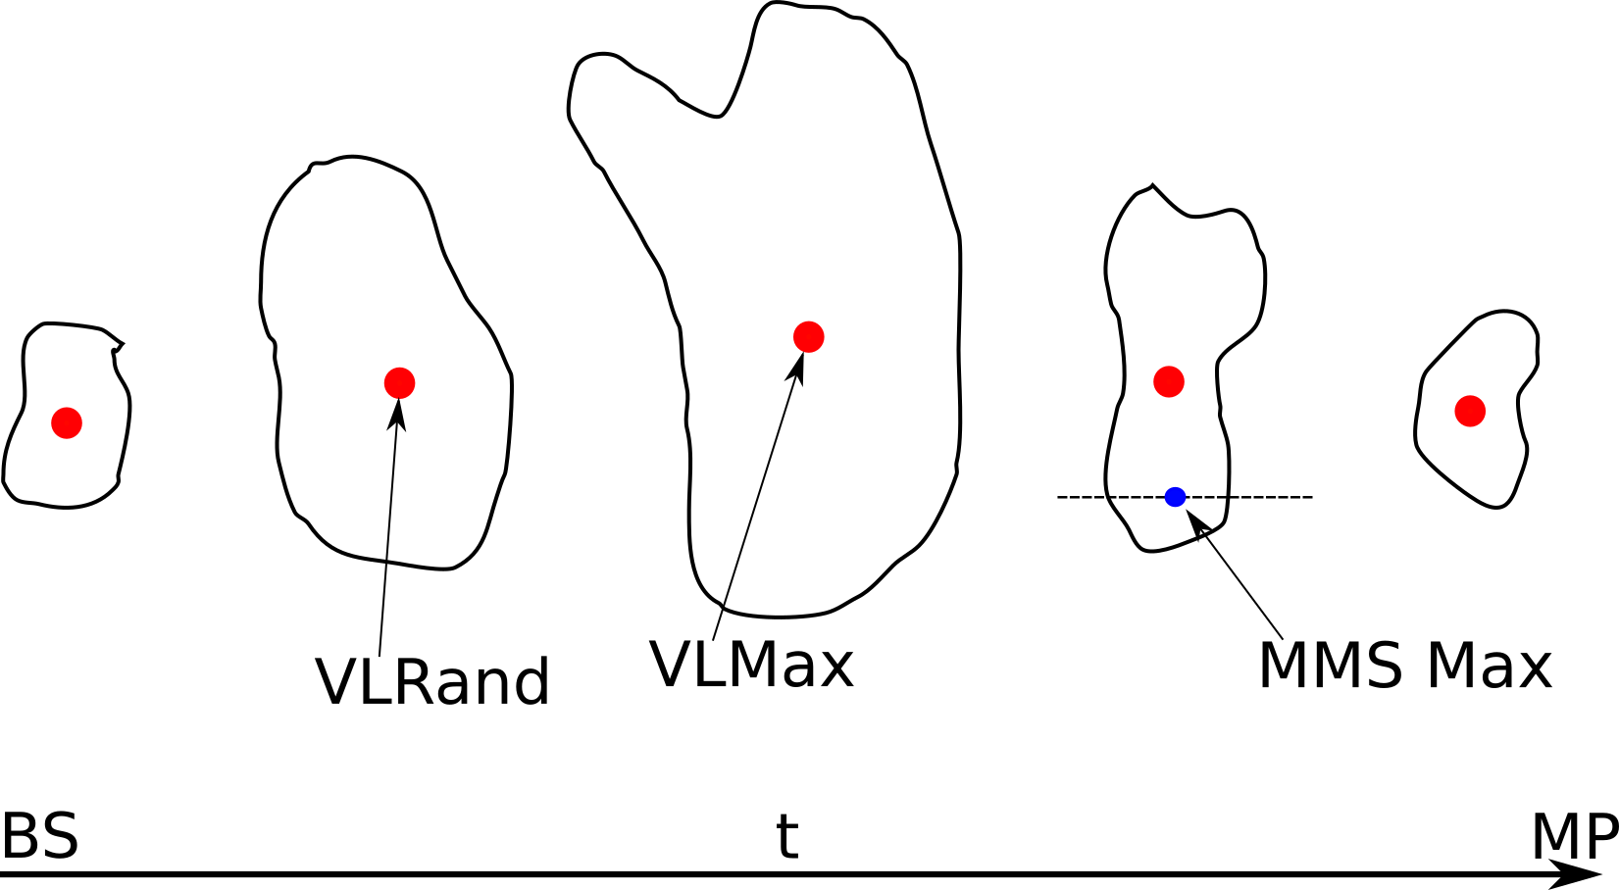
Main Difference between MMS & Vlasiator
Palmroth M., Raptis S., et al. (2021) | Annales
Notes:
Another difference = Solar Wind Conditions

Slide 23
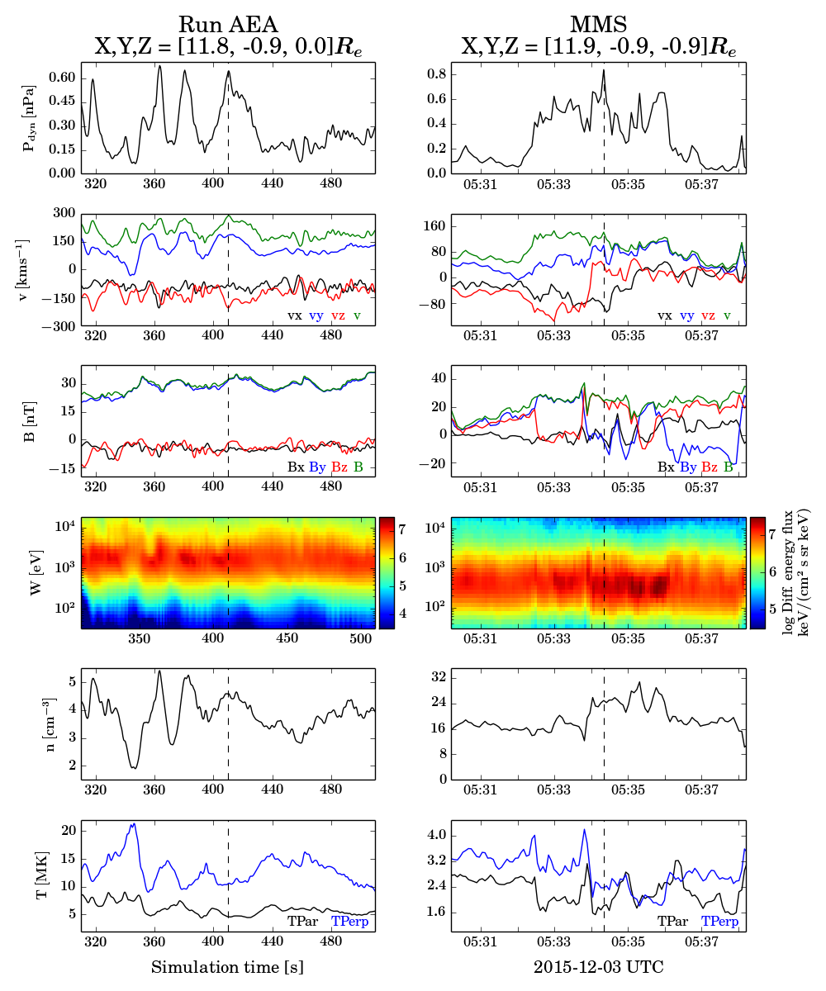
Case Comparison
Dynamic Pressure
Velocity
Magnetic Field
Ion Energy Spectrum
Density
Temperature
Palmroth M., Raptis S., et al. (2021) | Annales

Slide 24
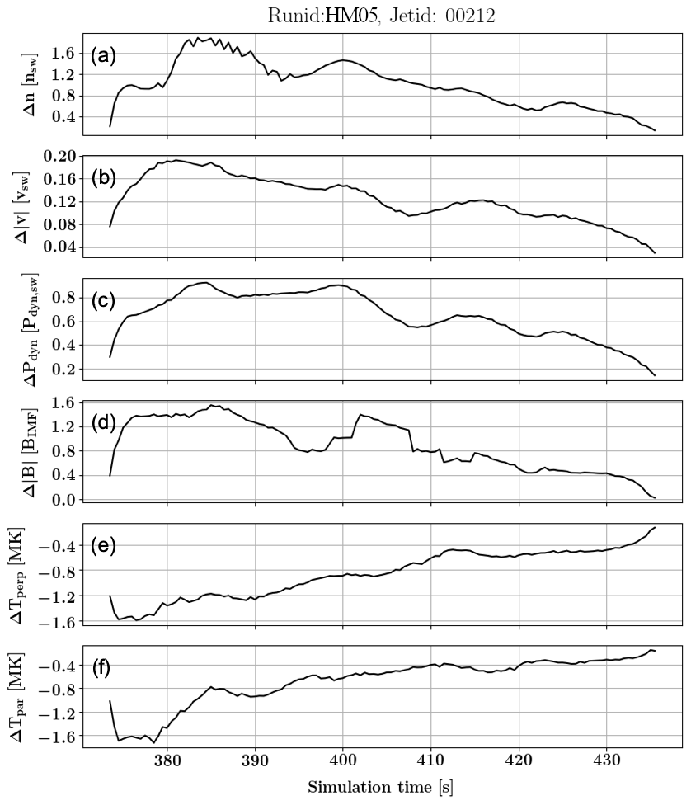
An evolution of a jet using Vlasiator
Palmroth M., Raptis S., et al. (2021) | Annales

Slide 25
What we learned so far

Slide 26
Jets & different techniques
Data & Statistics
Simulations
Machine Learning
Fluid (Ideal)
Hybrid (in-between)
Kinetic (complex)
Big things
Medium things
Small things

Slide 27
How are jets formed ?

Slide 28
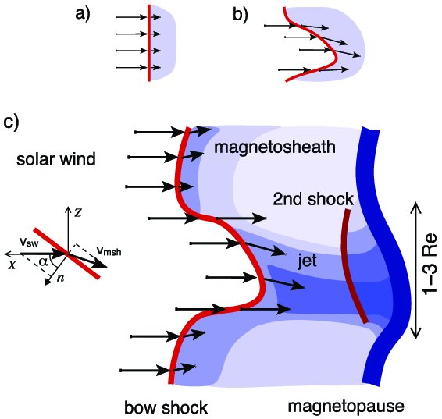
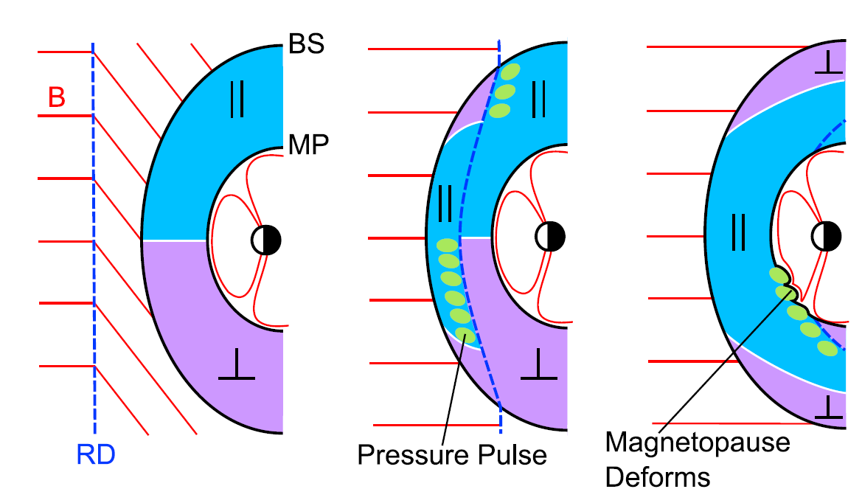
How are these jets created (Qpar) ?
Shock ripples
SW discontinuities
Foreshock Structures & Reformation
SW → locally inclined part of the bow shock → less deceleration and heating
RD → Change in Foreshock position → Pressure pulses
Hietala et al. (2009,2012)
Archer et al. (2012)
Karlsson et al.(2015), Suni et al. (2021), Raptis et al. (2022a)

Slide 29
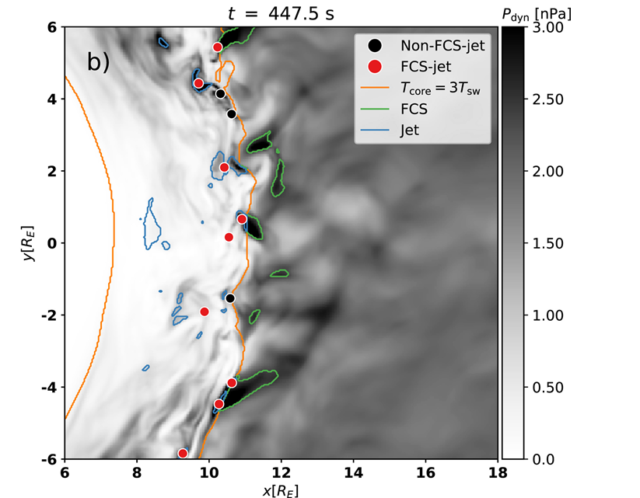
Why foreshock & jets ?
Observations
Simulations
Karlsson et al. (2012, 2015):
Palmroth et al. (2018): “high-dynamic-pressure structure that reproduces observational features associated with a short, large-amplitude magnetic structure (SLAMS)”
Embedded plasmoid = density
Fast plasmoid = density + velocity
“…plasmoids, … properties in common with SLAMS…”
Suni et al. (2021): “We find that 75% of jets are caused by Forceshock Compressive Structures”
Raptis et al. (2020): “… SLAMS-associated mechanisms are therefore supported and appear to be key elements of jet formation... “
HFA : Savin et al. (2012)
SHFA : Zhang et al. (2013)
Foreshock Cavities : Sibeck et al. (2021)
HFA: Omidi et al. (2013)

Slide 30
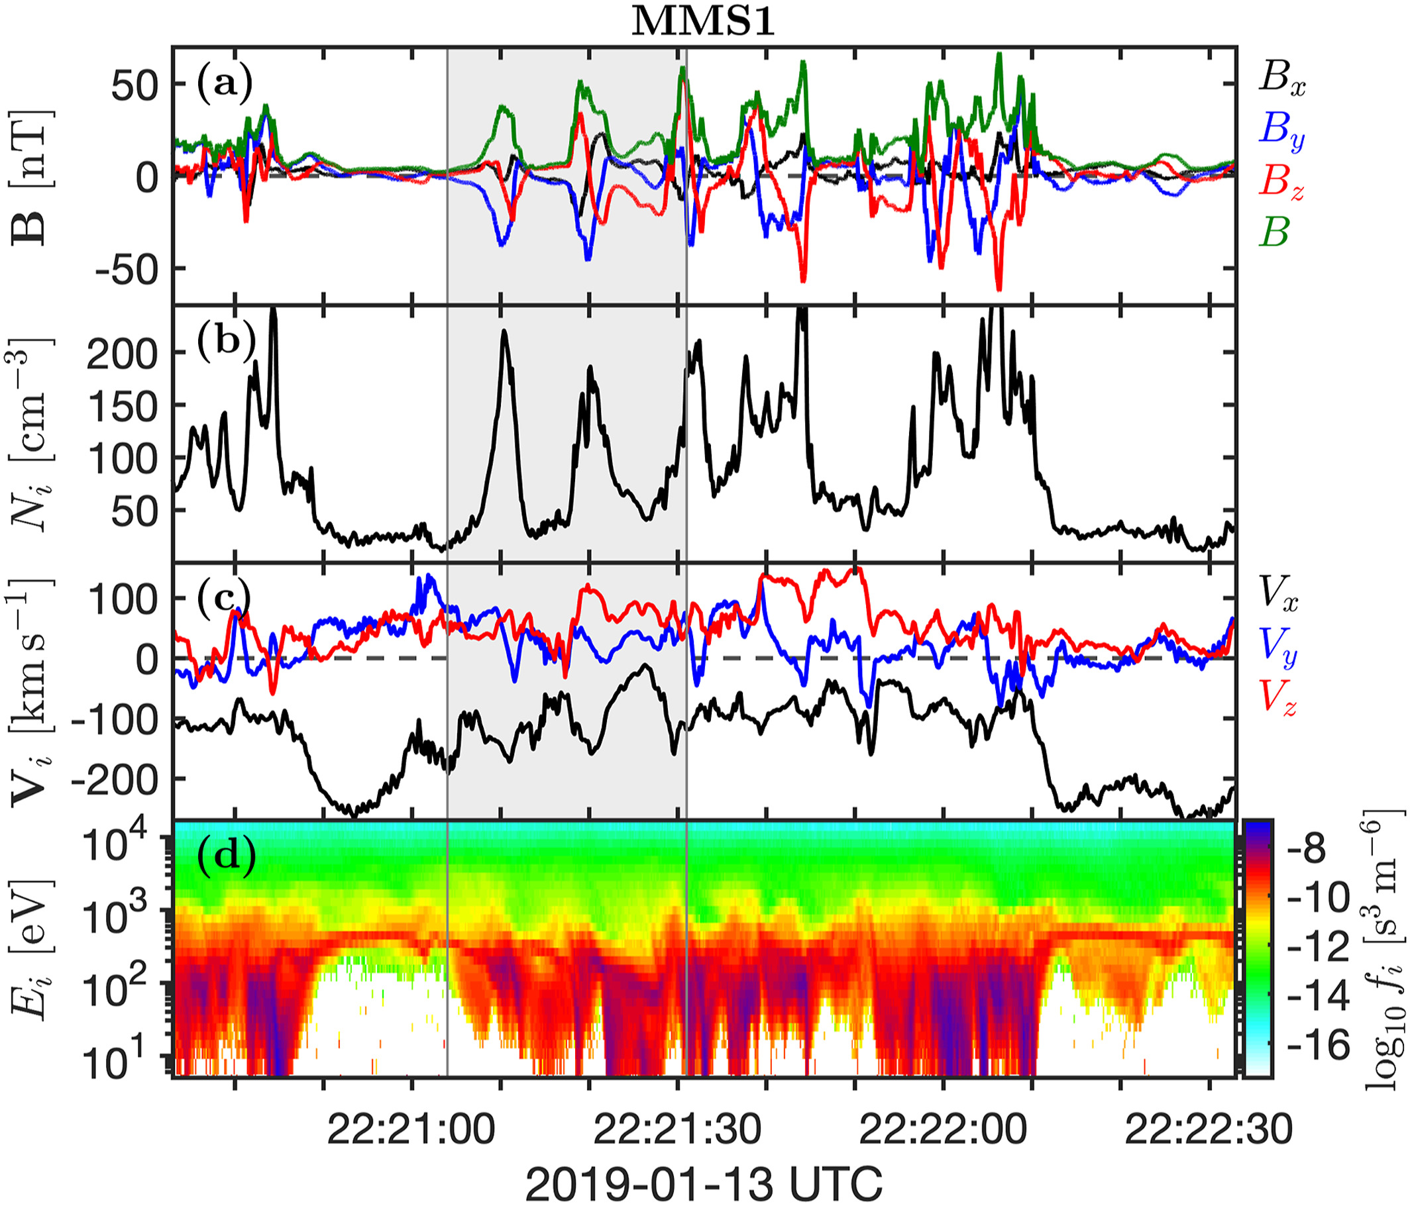
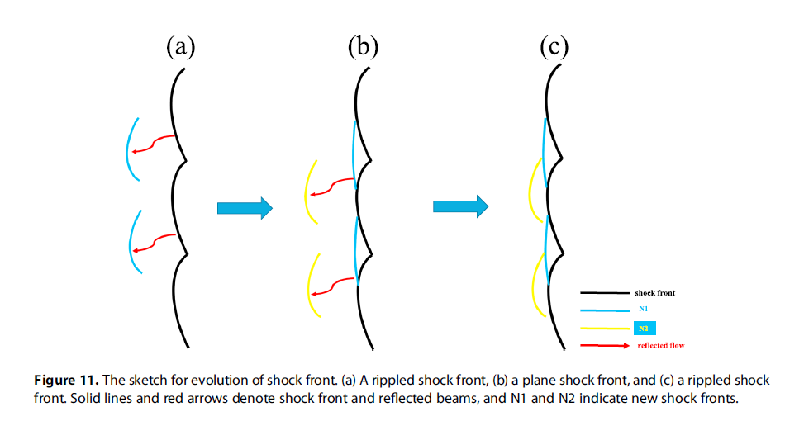
Shock Reformation
Shock Reformation
Burgess (1989): “the shock exhibits a cyclic behavior ….. cyclic shock reformation;”
Hao et al. (2017)
Similar definitions : Hao et al. (2016,2017), Liu et al. (2021), Johlander et al. (2022), Raptis et al. (2022)
Johlander et al. (2022)

Slide 31


New Results
2022
Fluid (Ideal)
Hybrid (in-between)
Kinetic (complex)
Big things
Medium things
Small things
Raptis, S. et al. Downstream high-speed plasma jet generation as a direct consequence of shock reformation. Nature Communications 13, 598 (2022). https://doi.org/10.1038/s41467-022-28110-4
Raptis, S. et al. On Magnetosheath Jet Kinetic Structure and Plasma Properties. Geophysical Research Letters (GRL) (2022 - Under Review)
GitHub : https://github.com/SavvasRaptis/Jets-Reformation
Notes:
~25 min

Slide 32
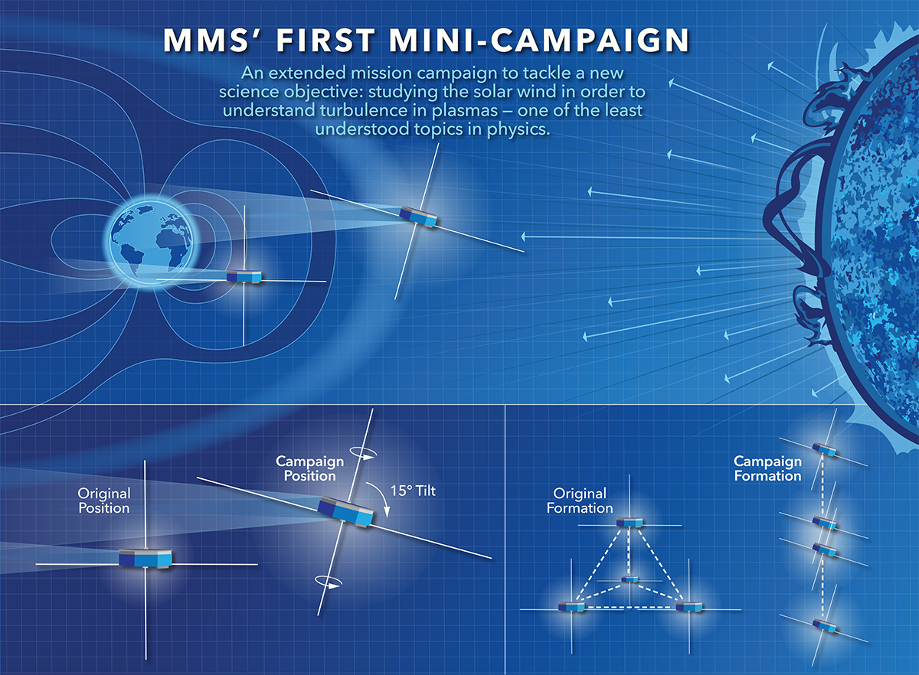


MMS spacecraft + String of Pearl Configuration
Bow Shock
Magnetopause
Earth
Credits: NASA's Goddard Space Flight Center/Mary Pat Hrybyk-Keith

Slide 33
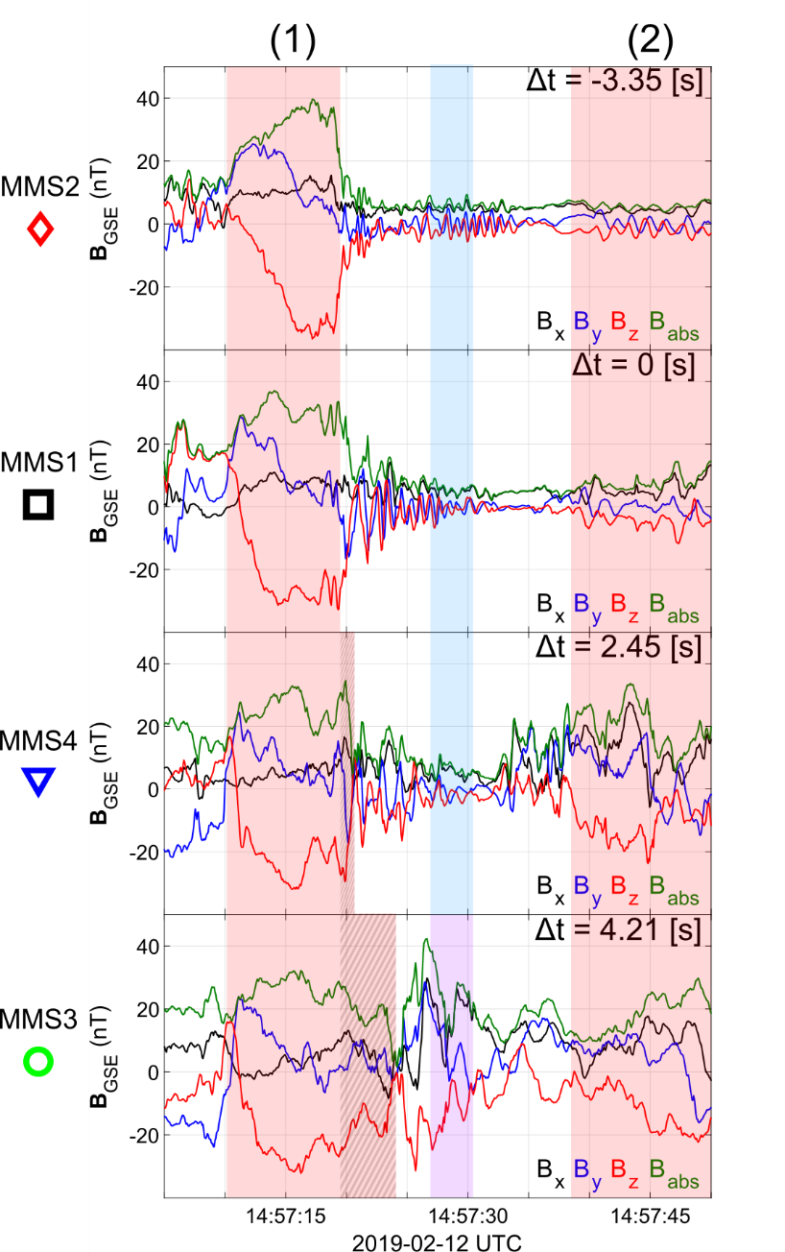
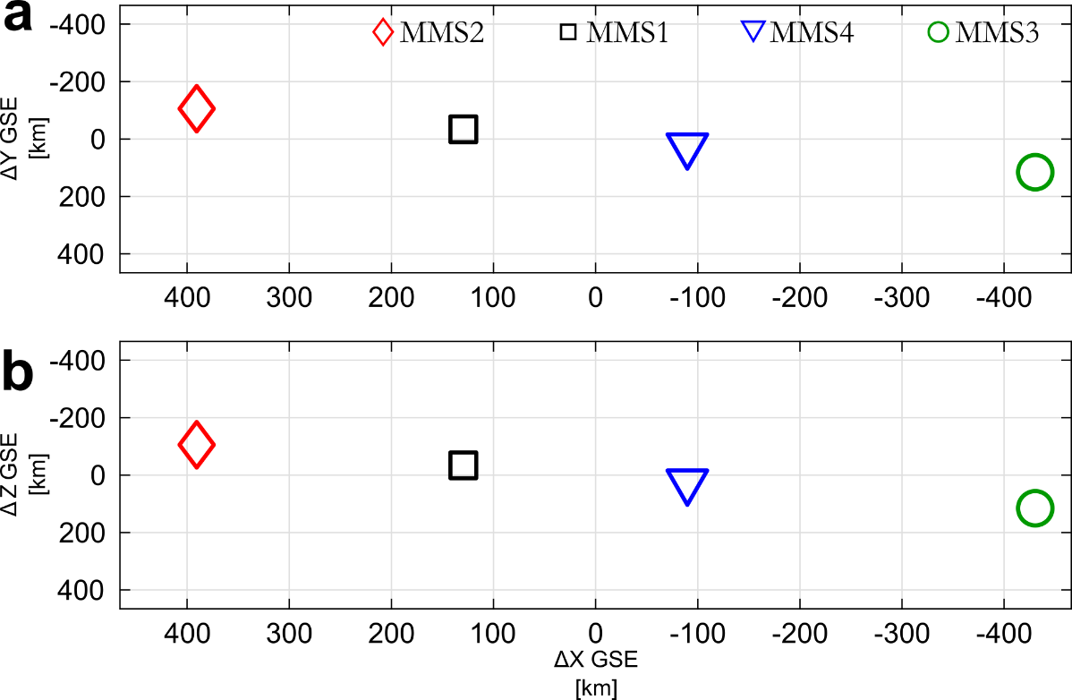
SLAMS & wave activity co-moving picture
Evolution of SLAMS
Interaction with upstream whistler
New peak /evolution*
Formation of downstream density enhancement**
* See similar examples by Turner et al. (2021), Chen et al. (2021)
** See similar example by Liu et al. (2021)

Slide 34
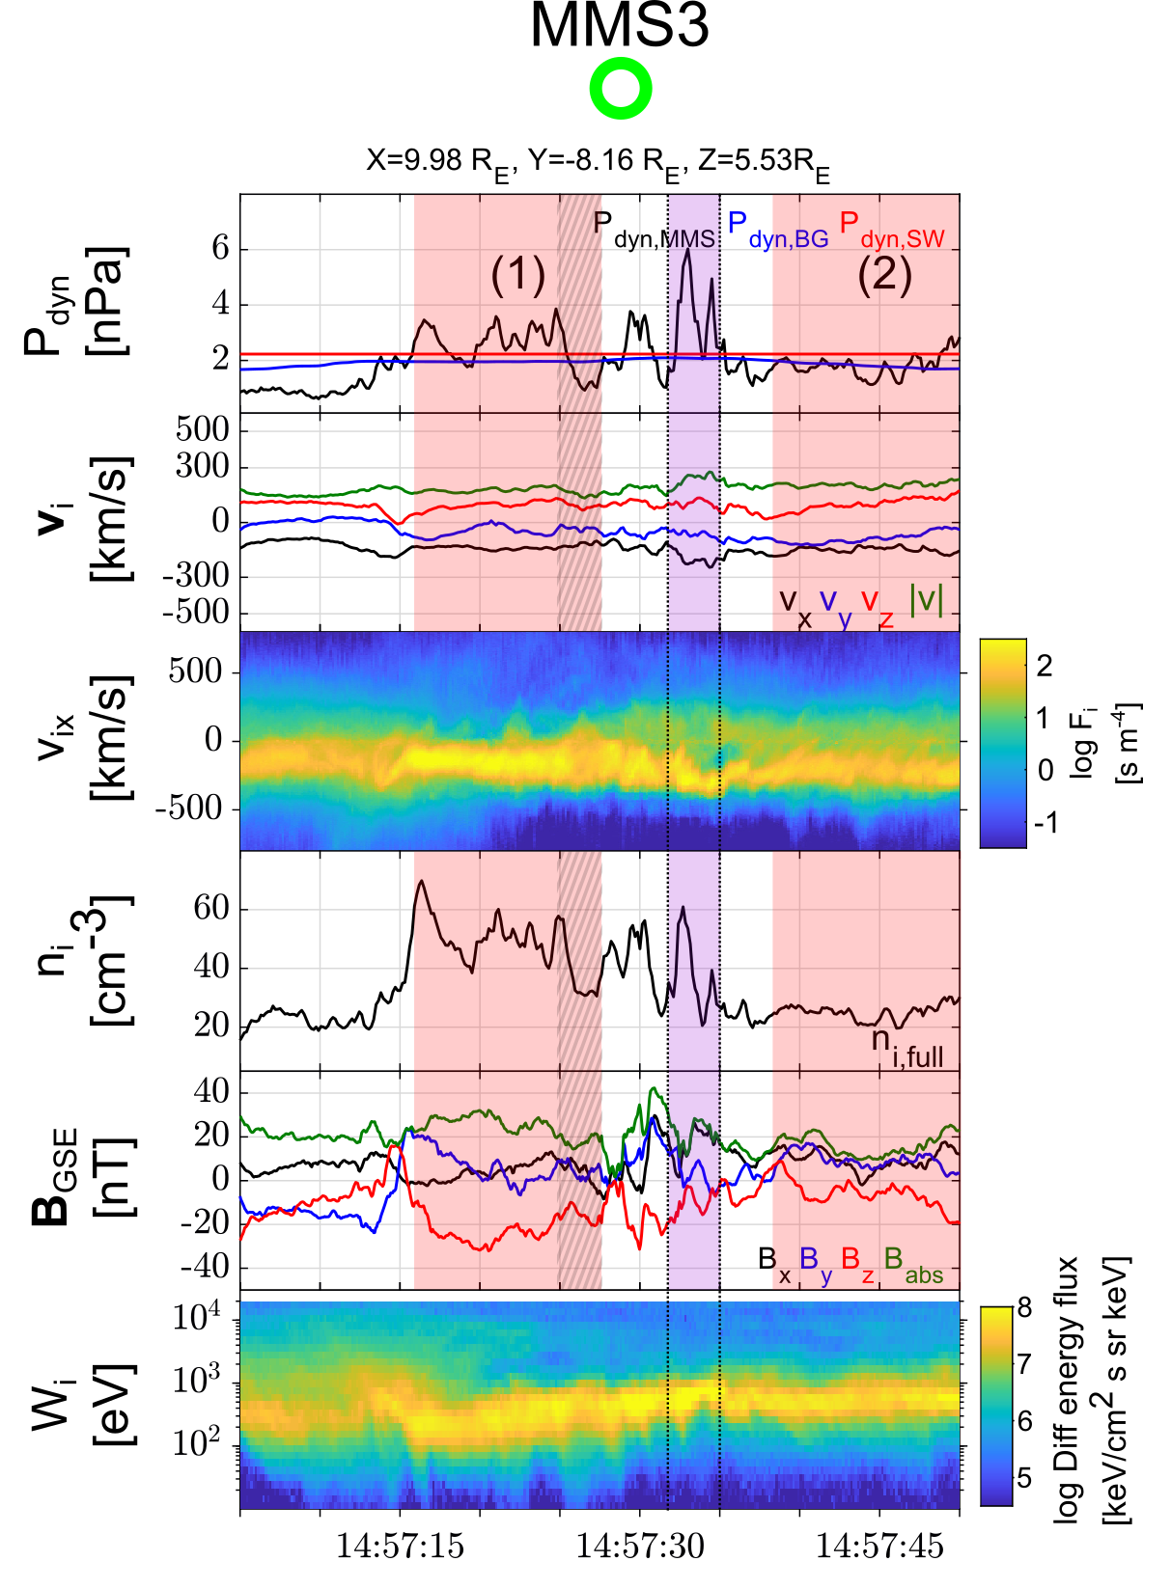
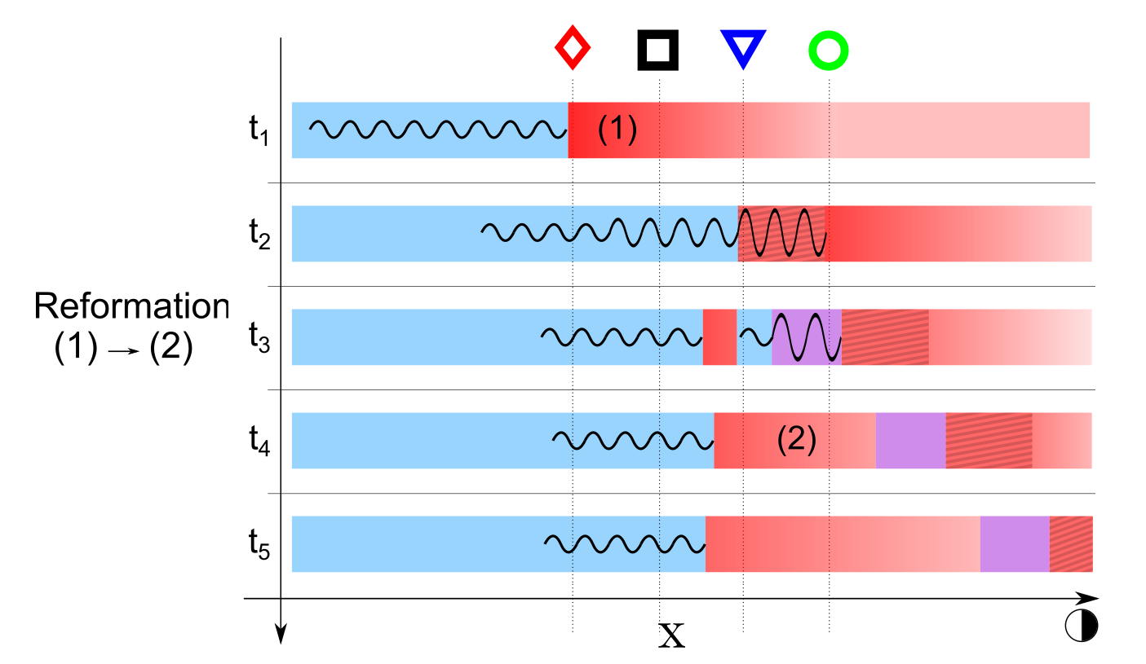
Shock Reformation & Magnetosheath Jets
Raptis S., et al. (2022a) | Nature Communications

Slide 35
What happens after jets are formed ?
Raptis, S. et al. On Magnetosheath Jet Kinetic Structure and Plasma Properties. Geophysical Research Letters (GRL) (2022 - Under Review)

Slide 36
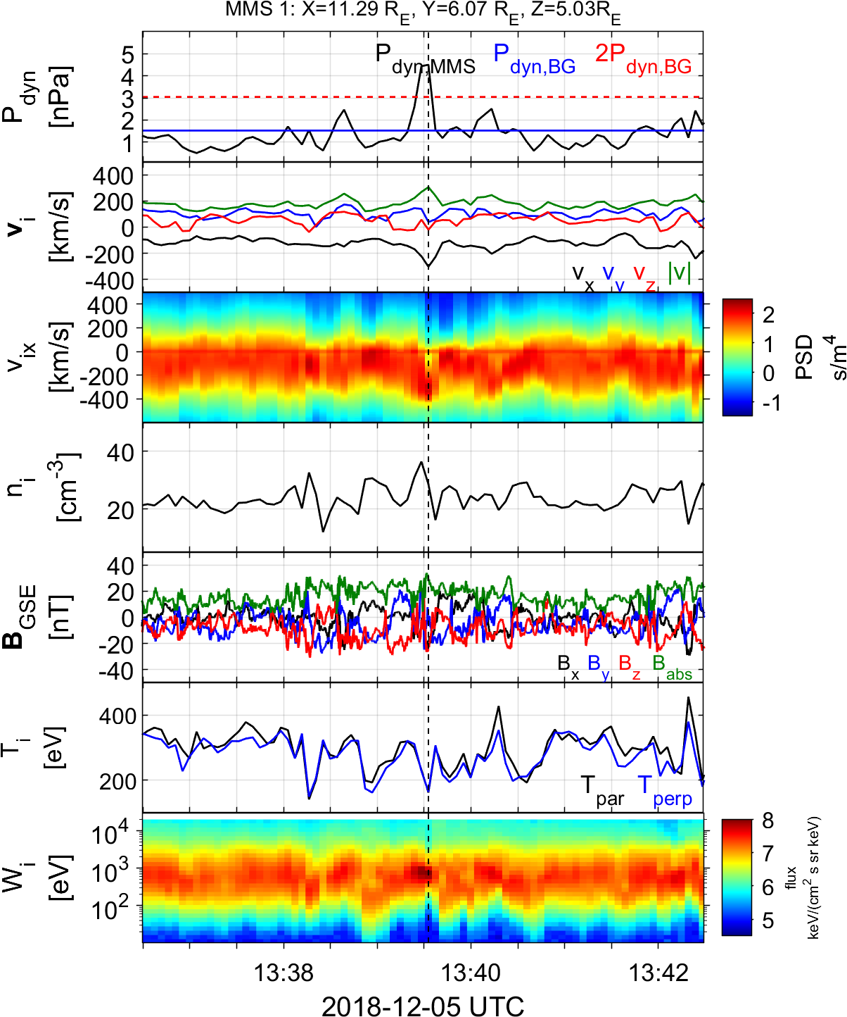
Qpar Magnetosheath jet – Fast data
Qpar Magnetosheath:
High energy ions
Low temperature anisotropy
High B Variance
Magnetosheath Jet
$$|V|↑$$
$$V_{x}↑$$
$$n↑$$
$$P_{dyn}>2 P_{dyn,BG}$$
Raptis S, et al,. 2022b | GRL (Under Review)

Slide 37
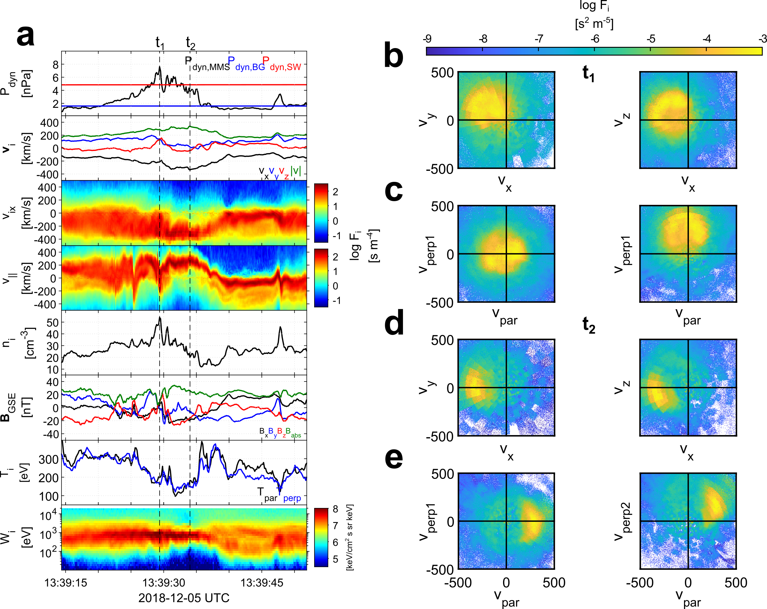
Qpar Magnetosheath jet – MMS Burst data
Areas of Interest
Pre jet = Typical MSH
$t_{1}=P_{dyn}$ peak
$t_{2}=|V|$ peak
Raptis S, et al,. 2022b | GRL (Under Review)

Slide 38
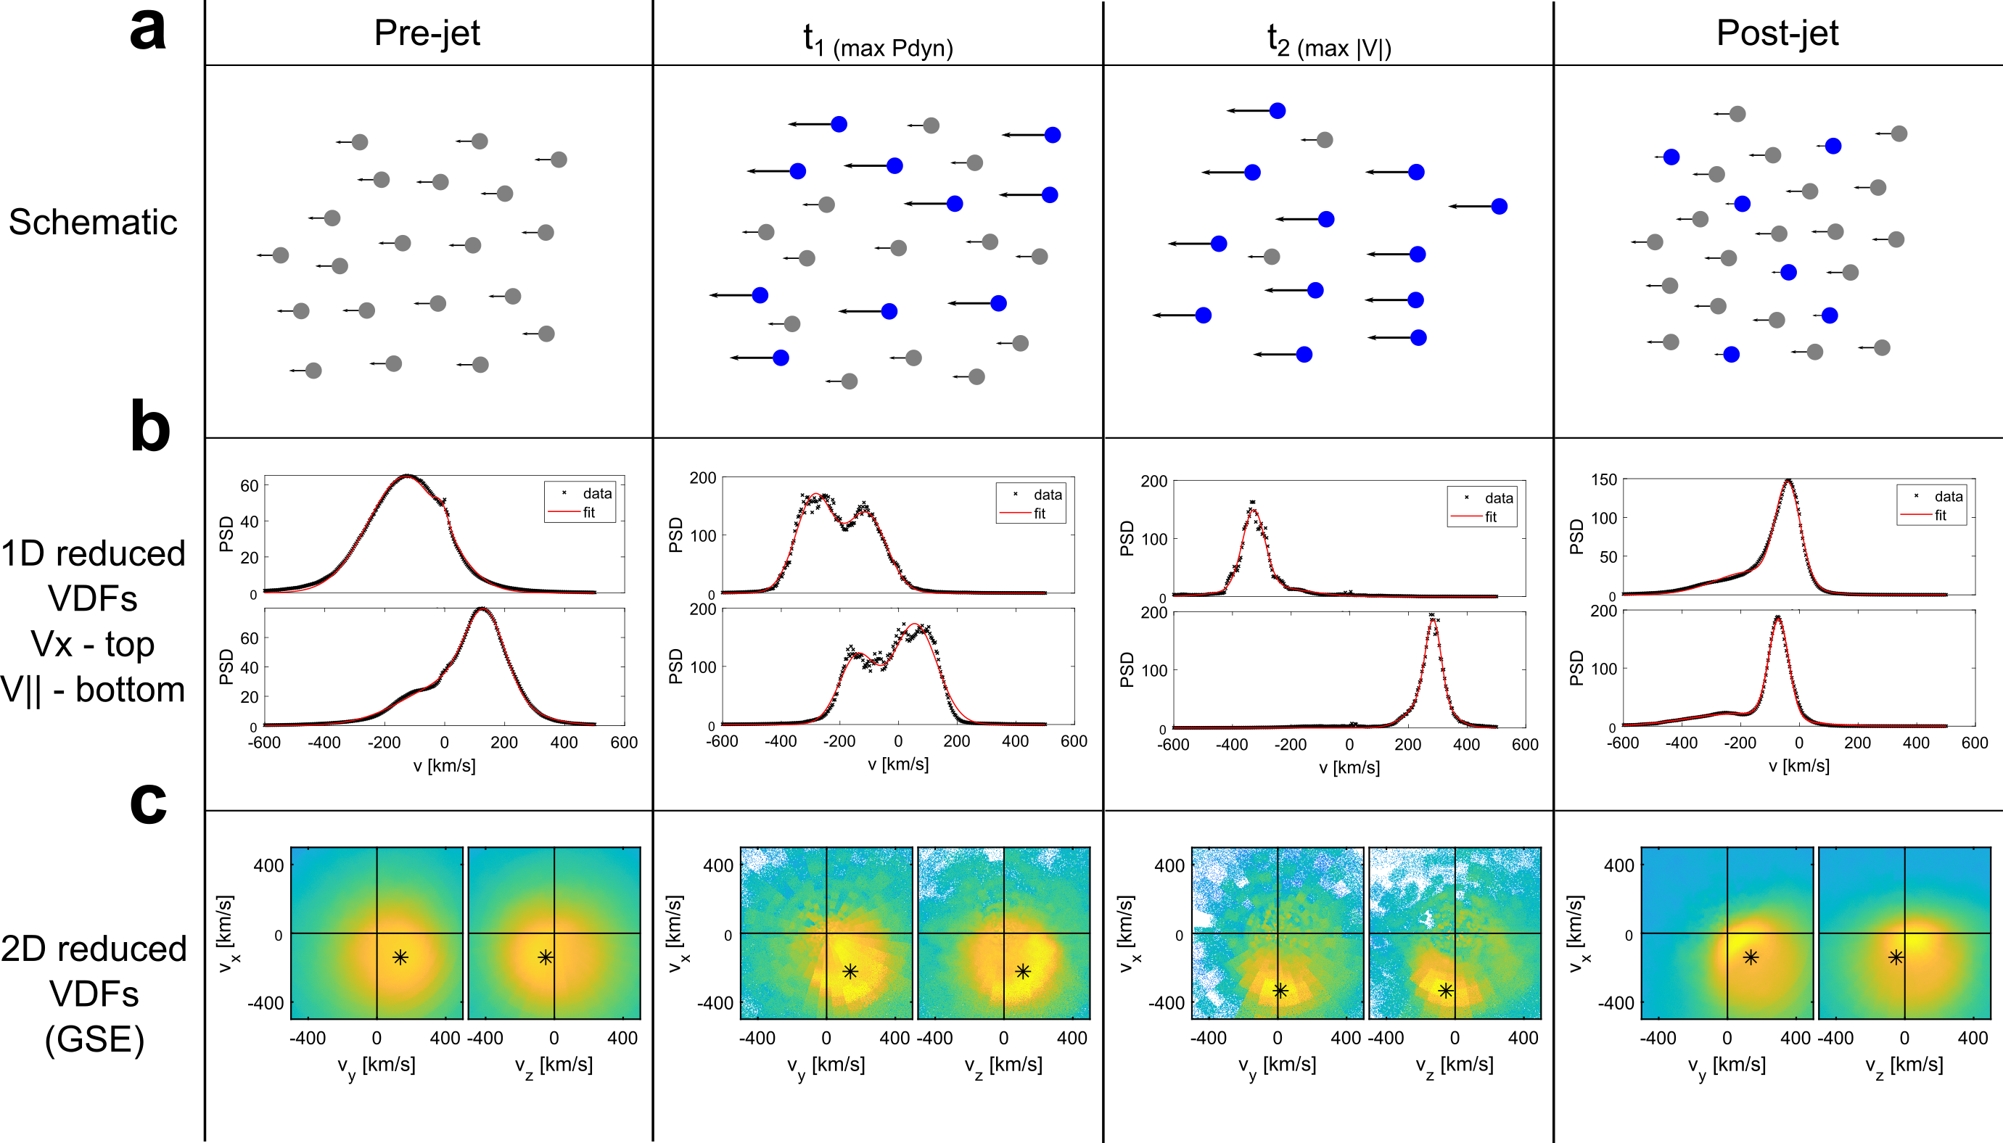
Jet evolution in Qpar Magnetosheath
Raptis S, et al,. 2022b | GRL (Under Review)

Slide 39
Jet evolution in Qpar Magnetosheath
Raptis S, et al,. 2022b | GRL (Under Review)

Slide 40
Jet evolution in Qpar Magnetosheath
Raptis S, et al,. 2022b | GRL (Under Review)

Slide 41
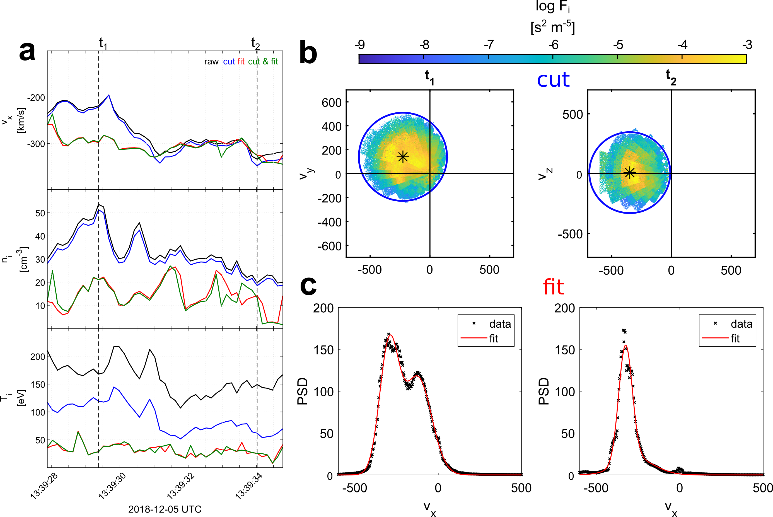
Partial Moment Derivation
Methods:
Cut : 1$v_{th}$ sphere in 3D VDF around bulk velocity
Fit : Fit 2 Maxwellians in 1D reduced VDFs
Raptis S, et al,. 2022b | GRL (Under Review)

Slide 42
Outlook & discussion

Slide 43
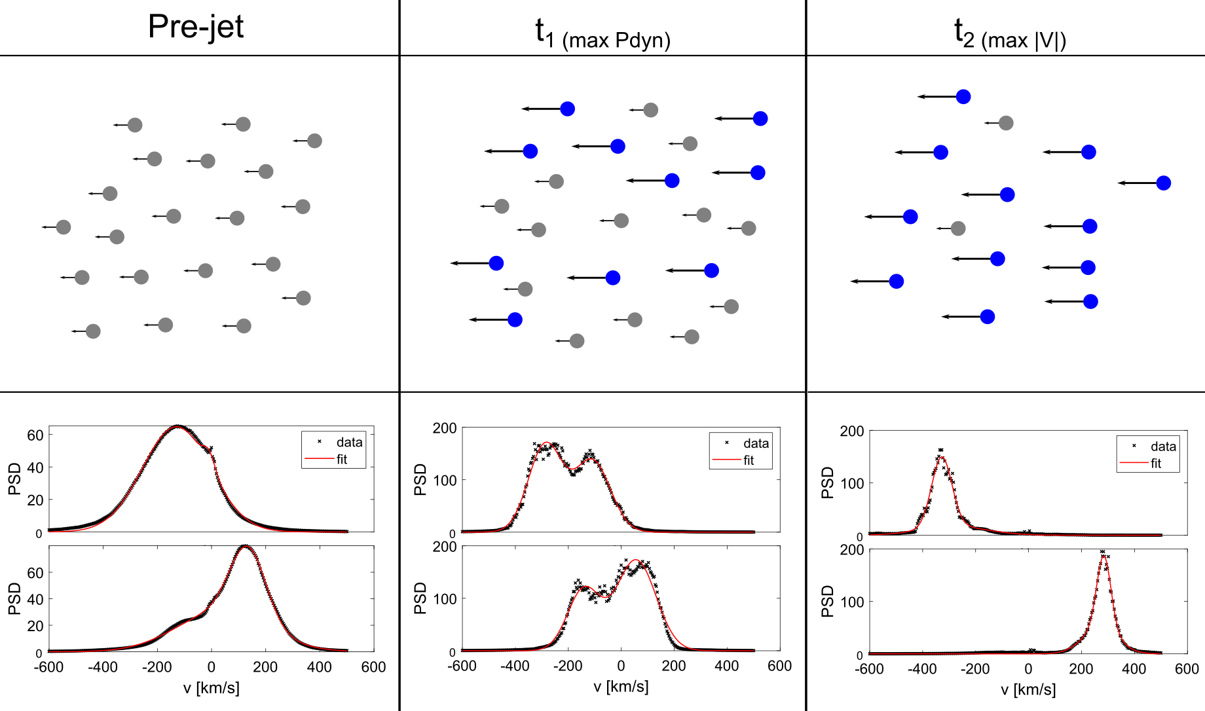
Discussion
Question 1
Question 2
Question 3
How do they form ?
What are their typical properties
& relation to shock?
How they evolve
& interact with MSH plasma?
Importance of classes in statistics & big picture
Shock relevance, complex structure & fluid picture limitations
Foreshock & shock reformation
Raptis S., et al. (2020) | JGR
Raptis S., et al. (2020) | Frontiers
Palmroth M., Raptis S., et al. (2021) | Annales
Karlsson, Raptis et al. (2021) | JGR
Kajdic P., Raptis S., et al. (2021) | GRL
Raptis S., et al. (2022b) | GRL (Under review)
Raptis S., et al. (2020) | JGR
Raptis S., et al. (2022a) | Nature Communications
Raptis S., et al. (2022a) | Nature Communications
Raptis S., et al. (2022b) | GRL (Under review)

Slide 44
Open questions
Are jets a global phenomenon ?
How do VDFs change as jets approach the magnetopause?
Which are the different waves excited by the interaction of jets with MSH?
Do jets contribute to the turbulence of the magnetosheath ?
Should we re-evaluate the definition based on the VDFs rather than plasma moments?
How are the statistics affected by the time resolution and plasma moment derivation ?
And many more…

Slide 45


A lot of data are not fully used (conjunction example)
Without even discussing missions away from Earth’s environment
Thank you, a lot, for listening ☺
Credits : Savvas Raptis

Slide 46
Extras

Slide 47

Fast/Survey MMS data
Burst MMS data
Resolution (samples/s)
Resolution (samples/s)
FGM (magnetic field):
FPI (plasma moments | ions):
EDP (electric field):
0.0625
4.5
0.0313
0.0078
0.15
0.00012218
Pros
Always available
Decent resolution
Can be good for statistics due to availability
Pros
Very high resolution
Able to resolve smaller scale structures close to boundary surfaces (e.g., mix of plasma close to magnetopause, bow shock, foreshock etc.)
Cons
Not available all the time, mostly available close to vital mission objectives (magnetopause, diffusion regions, shock transitions etc.)
Hard to do proper large-scale statistics due to biases generated from specific availability and manual choice of intervals
Cons
Not suitable for small scale studies especially these related to electron moments
Could be misleading close to boundary surfaces (Magnetopause, Bow shock etc.) due to very similar observational signatures
More information: Baker, et al. (2016) | Space Sci Rev 19

Slide 48
MMS – Jet Database
Fast/Survey
Burst
9/2015 - 9/2020
Jets with full burst data
Qpar | 423
Qperp | 34
Boundary | 35
Encapsulated | 31
Close to BS / MP | 495
Others | 428
Raptis S., Karlsson T., et al. (2020) | JGR
Raptis S., Aminalragia-Giamini S., et al. (2020) | Frontiers
Palmroth M., Raptis S., et al. (2021) | Annales
Kajdic P., Raptis S., et al. (2021) | GRL
Raptis S., Karlsson T., et al. (2022a) | Nat. Commun
Raptis S., Karlsson T., et al. (2022b) | GRL

Slide 49



General Observations of MMS
u
d
Solar Wind:
$$v_{x}≫$$
$$v_{y,z}\sim 0$$
$$n_{i}≪$$
$$B≪$$
Beam like distribution
Foreshock → Magnetosheath
(compressed – thermalized plasma)
$$v≪v_{SW}$$
$$n_{i}≫n_{SW}$$
$$B≫$$
Thermalized distribution

Slide 50


Jets interaction with ambient plasma
Liu et al. (2020)
Plaschke et al. (2018,2020)

Slide 51




Shock Reformation – Simulations
1D-PIC simulation (30$°$), $M_{A}=4.7$
mi/me = 50 and ωpe/Ωce = 4.
mi/me = 100 and ωpe/Ωce = $\sqrt{10}$.
Scholer et al. (2003) | JGR
Tsubouchi & Lembège (2004) | JGR
More nice sources for review : Burgess & Scholer (2015), Willson (2016)
Notes:
Scholer : MA = 4.7 shock with a mass ratio of mi/me = 100 and ωpe/Ωce = √10 are shown in Fig. The total system size for this simulation is 200c/ωpi.

Slide 52

Shock Reformation & SLAMS – Clarification
Shock Reformation
Burgess (1989): “the shock exhibits a cyclic behavior ….. cyclic shock reformation;”
ULF non-linear evolution = SLAMS
Chen et al. (2020): “…ULF waves can arise at the foreshock and evolve into SLAMS …”
Hao et al. (2017)
Schwartz, (1991)
Similar definitions : Hao et al. (2016,2017), Liu et al. (2021), Johlander et al. (2022), Raptis et al. (2022)
Lucek, (2008)

Slide 53

Shock Reformation – Latest Results
Liu et al. (2021)
Johlander et al. (2022)

Slide 54

Neural Networks with Images

Slide 55

Neural Networks with Images – Dog example

Slide 56
Convolution Neural Networks

Slide 57


Convolution Neural Network (CNN) Layers
Convolution
Extract features & Keep spatial relationship
Pooling/Subsampling
Reduce dimensionality & retain information
*Figure Courtesy: Erik Reppel
*Figure Courtesy: Cambridge Spark Ltd

Slide 58



Example of CNN
*Figure Courtesy: Suhyun Kim iSystems Design Labs

